Slide 1

Database Technologies - MongoDB
All of us do not have equal talent. But, all of us have an equal opportunity to develop our talents.
A.P.J. Abdul Kalam
sudo apt install build-essential
Enterprise primaryDB> config.set("editor", "notepad++")
Enterprise primaryDB> config.set("editor", null)

Slide 2
Class Room
Session 1

Slide 3
Big Data?
Big data is a term that describes the large volume of data – both structured and unstructured.
What is Big Data?
Big Data is also data but with a huge size. Big Data is a term used to describe a collection of data that is huge in size and yet growing with time. In short such data is so large and complex that none of the traditional data management tools are able to store it or process it efficiently.
Characteristics Of Big Data
Big data is often characterized by the 3Vs: the extreme VOLUME of data, the wide VARIETY of data and the VELOCITY at which the data must be processed.

Slide 4

NoSQL, which stands for "Not Only SQL" which is an alternative to traditional relational databases in which data is placed in tables and data schema is carefully designed before the database is built.
NoSQL
NoSQL database are primarily called as non-SQL or non-relational database. MongoDB is Scalable (able to be changed in size or scale), open-source, high-perform, document-oriented database.
Remember:
Horizontal scaling means that you scale by adding more machines into your pool of resources.
Vertical scaling means that you scale by adding more power (CPU, RAM) to an existing machine.

Slide 5
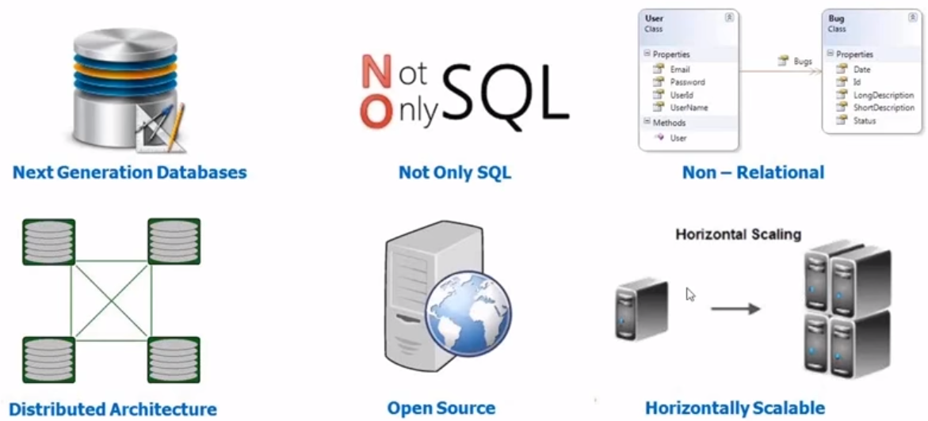
why NoSQL

Slide 6
when to use NoSQL
When should NoSQL be used:
When huge amount of data need to be stored and retrieved .
The relationship between the data you store is not that important
The data changing over time and is not structured.
Support of Constraints and Joins is not required at database level.
The data is growing continuously and you need to scale the database regular to handle the data.
Remember:
Data Persistence on Server-Side via NoSQL.
Does not use SQL-like query language.
Longer persistence
Store massive amounts of data.
Systems can be scaled.
High availability.
Semi-structured data.
Support for numerous concurrent connections.
Indexing of records for faster retrieval

Slide 7
NoSQL Categories

Slide 8
NoSQL Categories
There are 4 basic types of NoSQL databases.
Key-value stores | Key-value stores, or key-value databases, implement a simple data model that pairs a unique key with an associated value. e.g. Redis
Column-oriented | Wide-column stores organize data tables as columns instead of as rows. e.g. hBase, Cassandra
Document oriented | Document databases, also called document stores, store semi-structured data and descriptions of that data in document format. e.g. MongoDB, CouchDB
Graph | Graph data stores organize data as nodes. e.g. Neo4j

Slide 9
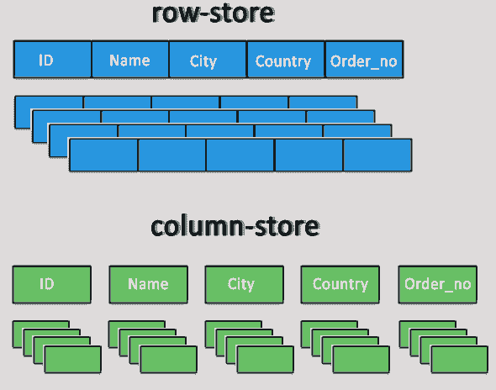
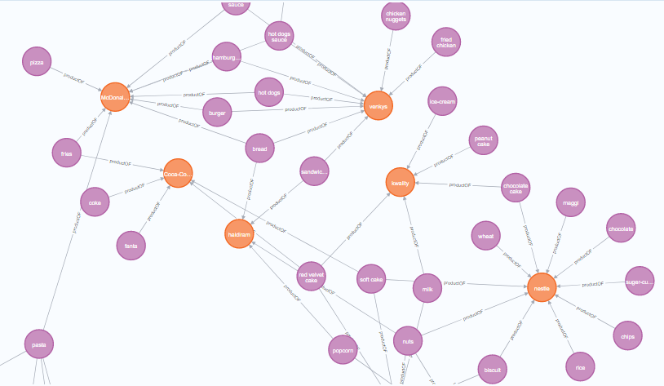
NoSQL Categories
Column-oriented
Graph

Slide 10
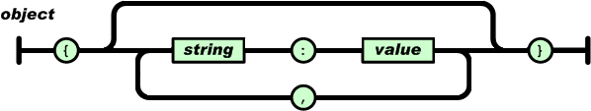
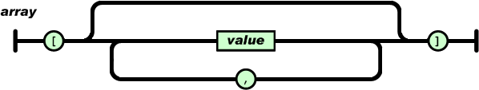
An object is an unordered set of name/value pairs.
An array is an ordered collection of values.

Slide 11
SQL vs NoSQL Database
Relational databases are commonly referred to as SQL databases because they use SQL (structured query language) as a way of storing and querying the data.
Difference:
NoSQL databases are document based, key-value pairs, or wide-column stores. This means that SQL databases represent data in form of tables which consists of n number of rows of data whereas NoSQL databases are the collection of key-value pair, documents, or wide-column stores which do not have standard schema definitions.
SQL databases have predefined schema whereas NoSQL databases have dynamic schema for unstructured data.
SQL requires a predefined schema, meaning the structure of the data (tables, columns, data types) needs to be defined before data can be inserted whereas NoSQL typically has a dynamic or schema-less approach, allowing for flexibility in the data structure. New fields can be added without requiring a predefined schema.
SQL databases are vertically scalable whereas the NoSQL databases are horizontally scalable.
SQL databases uses SQL ( structured query language ) for defining and manipulating the data. In NoSQL database, queries are focused on collection of documents.

Slide 12
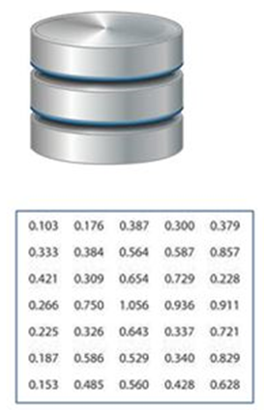
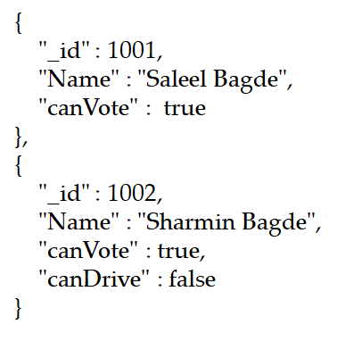

Types of Data
Structured
Semi-Structured
Unstructured
MongoDB stores documents (objects) in a format called BSON.
BSON is a binary serialization of JSON

Slide 13
Types of Data
Structured
The data that can be stored and processed in a fixed format is called as Structured Data. Data stored in a relational database management system (RDBMS) is one example of ‘structured’ data. It is easy to process structured data as it has a fixed schema. Structured Query Language (SQL) is often used to manage such kind of Data.
Semi-Structured
Semi-Structured Data is a type of data which does not have a formal structure of a data model, i.e. a table definition in a relational DBMS, XML files or JSON documents are examples of semi-structured data.
Unstructured
The data which have unknown form and cannot be stored in RDBMS and cannot be analyzed unless it is transformed into a structured format is called as unstructured data. Text Files and multimedia contents like images, audios, videos are example of unstructured data.

Slide 14
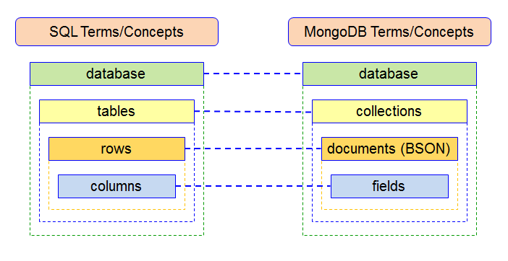
MongoDB
MongoDB is a cross-platform document-oriented database program. Classified as a NoSQL database.
Remember:
MongoDB documents are similar to JSON (key/fields and value pairs) objects.
The values of fields may include other documents, arrays, or an arrays of documents.
Core MongoDB Operations (CRUD), stands for create, read, update, and delete.
SQL/MongoDB Terms:

Slide 15
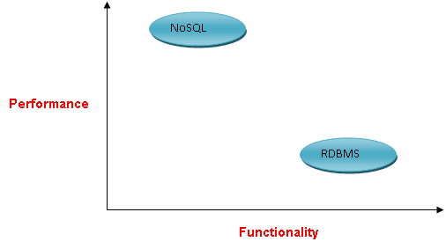
MongoDB
MongoDB stores data as BSON documents. BSON is a binary representation of JSON documents.
JSON (JavaScript Object Notation) is a lightweight data-interchange format. It is easy for humans to read and write.

Slide 16
3Vs
3Vs (volume, variety and velocity) are three defining properties or dimensions of big data.
Volume refers to the amount of data.
Variety refers to the number of types of data.
Velocity refers to the speed of data processing.

Slide 17



3Vs
Volume refers to the ‘amount of data’, which is growing day by day at a very fast pace. The size of data generated by humans, machines and their interactions on social media itself is massive.
Velocity is defined as the pace at which different sources generate the data every day. This flow of data is massive.
As there are many sources which are contributing to Big Data, the type of data they are generating is different. It can be structured, semi-structured or unstructured. Hence, there is a variety of data which is getting generated every day. Earlier, we used to get the data from excel and databases, now the data are coming in the form of images, audios, videos, sensor data etc. as shown in below image. Hence, this variety of unstructured data creates problems in capturing, storage, mining and analyzing the data.

Slide 18
cls
console.clear();
* MongoDB does not support duplicate field names
The maximum size an individual document can be in MongoDB is 16MB with a nested depth of 100 levels.
document
MongoDB stores data as BSON documents. BSON is a binary representation of JSON documents.
MongoDB's collections, by default, do not require their documents to have the same schema. That is:
The documents in a single collection do not need to have the same set of fields and the data type for a field can differ across documents within a collection.
To change the structure of the documents in a collection, such as add new fields, remove existing fields, or change the field values to a new type, update the documents to the new structure.

Slide 19
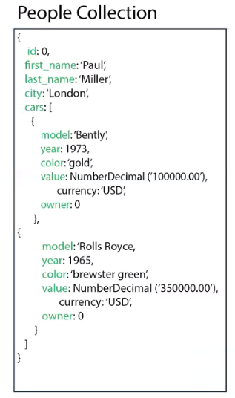
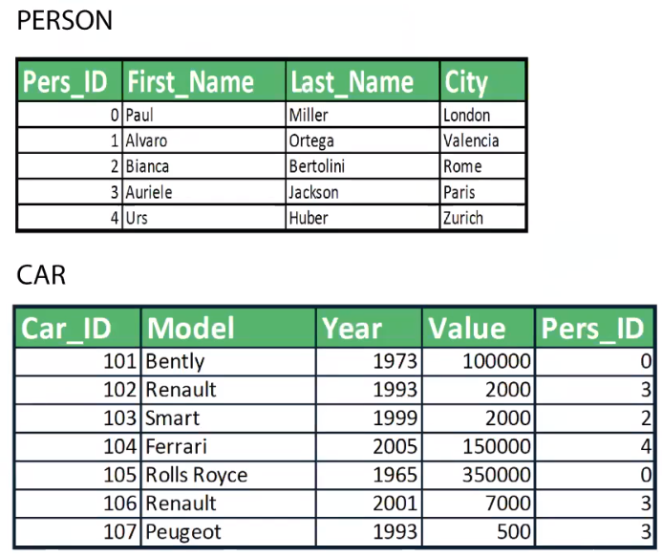
document

Slide 20

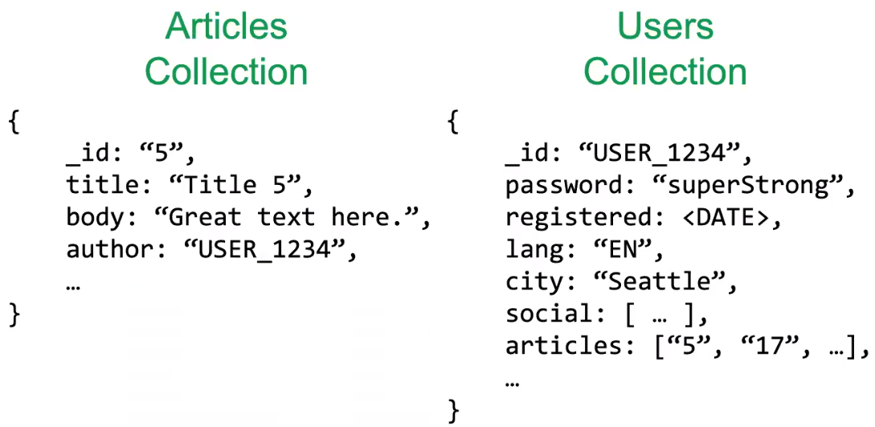
document

Slide 21
document
MongoDB documents are composed of field-and-value pairs. The value of a field can be any of the BSON data types, including other documents, arrays, and arrays of documents.
The field name _id is reserved for use as a primary key; its value must be unique in the collection, is immutable, and may be of any type other than an array.
{
field1: value,
field2: value,
field3: [],
field4: {},
field5: [ {}, {}, ... ]
...
fieldN: valueN
}
The primary key _id is automatically added, if _id field is not specified.
Note:
The _id field is always the first field in the documents.
MongoDB does not support duplicate field names.

Slide 22
db
In the mongo shell, db is the variable that references the current database. The variable is automatically set to the default database test or is set when you use the use <db_name> to switch current database.

Slide 23
 | MongoDB | Redis | MySQL | Oracle
Database Server | mongod | ./redis-server | mysqld | oracle
Database Client | mongo | ./redis-cli | mysql | sqlplus
start db server

Slide 24
start server and client
To start MongoDB server, execute mongod.exe.
Note: Always give --dbpath in ""
The --dbpath option points to your database directory.
The --bind_ip_all option : bind to all ip addresses.
The --bind_ip arg option : comma separated list of ip addresses to listen on, localhost by default.
--bind_ip <hostnames | ipaddresses>
mongod --dbpath "c:\database" --bind_ip_all --journal
mongod --dbpath "c:\database" --bind_ip stp10 --journal
mongod --dbpath "c:\database" --bind_ip 192.168.100.20 --journal
mongod --dbpath="c:\database" --bind_ip=192.168.100.20 –journal
mongod –auth --dbpath="c:\database" --bind_ip=192.168.100.20 --journal
mongod --storageEngine inMemory --dbpath="d:\tmp" --bind_ip=192.168.100.20
To start MongoDB client, execute mongosh.exe.
must be empty folder
mongosh "192.168.100.20:27017/primaryDB"
mongosh --host 192.168.100.20 --port 27017
mongosh --host 192.168.100.20 --port 27017 primaryDB
mongosh --host=192.168.100.20 --port=27017 primaryDB
mongosh --host=192.168.100.20 --port=27017 –u user01 -p user01 --authenticationDatabase primaryDB

Slide 25
db.version(); # version number
db.getMongo(); # connection to 192.168.100.20:27017
db.hostInfo(); # Returns a document with information about the mongoDB is runs on.
db.stats(); # Returns DB status
getHostName(); # stp5
comparison operator

Slide 26
comparison operator
$eq | Matches values that are equal to a specified value.
$gt | Matches values that are greater than a specified value.
$gte | Matches values that are greater than or equal to a specified value.
$lt | Matches values that are less than a specified value.
$lte | Matches values that are less than or equal to a specified value.
$ne | Matches all values that are not equal to a specified value.
$in | Matches any of the values specified in an array.
$nin | Matches none of the values specified in an array.

Slide 27
comparison operator
$eq
$ne
{ field: { $eq: value } }
{ field: { $ne: value } }
$gt
$gte
{ field: { $gt: value } }
{ field: { $gte: value } }
$lt
$lte
{ field: { $lt: value } }
{ field: { $lte: value } }
$in
{ field: { $in: [ <value1>, <value2>, ..., <valueN> ] } }
$nin
{ field: { $nin: [ <value1>, <value2>, ..., <valueN> ] } }

Slide 28
logical operator

Slide 29
logical operator
$or | Joins query clauses with a logical OR returns all documents that match the conditions of either clause.
$and | Joins query clauses with a logical AND returns all documents that match the conditions of both clauses.
$not | Inverts the effect of a query expression and returns documents that do not match the query expression.
db.emp.find( { $or:[ { job: 'manager' }, { job: 'salesman' } ], $and: [ { sal: { $gt: 3000 }} ] }, { _id: false, ename: true, job: true, sal: true } );
db.emp.find({ JOB: { $in: [ 'manager', 'salesman' ] } }, { _id: false, ename: true, job: true });

Slide 30
logical operator
$or
{ $or: [ { <expr1> }, { <expr2> }, ... , { <exprN> } ] }
db.emp.find({$or: [{job: 'manager'}, {job: 'salesman'}]})
$and
{ $and: [ { <expr1> }, { <expr2> }, ... , { <exprN> } ] }
db.emp.find({$and: [{job:'manager'}, {sal:3400}]})
$not
{ field: { $not: { <operator-expression> } } }
db.emp.find({ job: {$not: {$eq: 'manager'}}})

Slide 31
ObjectId values are 12 bytes in length.
A 4-byte timestamp, representing the ObjectId's creation, measured in seconds.
A 5-byte random value generated once per process. This random value is unique to the machine and process.
A 3-byte incrementing counter, initialized to a random value.
ObjectId()
The ObjectId class is the default primary key for a MongoDB document and is usually found in the _id field in an inserted document.
The _id field must have a unique value. You can think of the _id field as the document’s primary key.

Slide 32
ObjectId()
MongoDB uses ObjectIds as the default value of _id field of each document, which is auto generated while the creation of any document.
ObjectId()
x = ObjectId()

Slide 33
show databases
Print a list of all available databases.

Slide 34
show database
Print a list of all databases on the server.
show { dbs | databases }
show dbs
show databases # returns: all database name.
db.adminCommand({ listDatabases: 1, nameOnly:true })
db.getName()
db
db.getName() # returns: the current database name.

Slide 35
To access an element of an array by the zero-based index position, concatenate the array name with the dot (.) and zero-based index position, and enclose in quotes
use database
Switch current database to <db>. The mongo shell variable db is set to the current database.

Slide 36
use database
Switch current database to <db>. The mongo shell variable db is set to the current database.
use <db>
use db1

Slide 37
db.dropDatabase()

Slide 38
db.dropDatabase()
Removes the current database, deleting the associated data files.
db.dropDatabase()
use db1
db.dropDatabase()

Slide 39
If not working then do changes in my.ini file.
secure_file_priv = ""
SELECT * FROM emp INTO OUTFILE "d:/emp.csv" FIELDS TERMINATED BY ',';
mongoimport
mongoimport tool imports content from an Extended JSON, CSV, or TSV export created by mongoexport, or another third-party export tool.

Slide 40
mongoimport - JSON
The mongoimport tool imports content from an Extended JSON, CSV, or TSV export created by mongoexport.
mongoimport < --host > < --port > < --db > < --collection > < --type > < --file > < --fields "Field-List" > < --mode { insert | upsert | merge } > < --jsonArray > < --drop >
< --jsonArray > # if the documents are in array i.e. in [] brackets
< --drop > # drops the collection if exists
C:\> mongoimport --host 192.168.0.3 --port 27017 --db db1 --collection emp --type json --file "d:\emp.json"
C:\> mongoimport --host 192.168.0.6 --port 27017 --db db1 --collection movies --type json --file "d:\movies.json" --jsonArray --drop

Slide 41
mongoimport - CSV
The mongoimport tool imports content from an Extended JSON, CSV, or TSV export created by mongoexport.
mongoimport < --host > < --port > < --db > < --collection > < --type > < --file > < --fields "<field1>[,<field2>,...]*" > < --columnsHaveTypes > < --headerline > < --useArrayIndexFields > < --drop >
C:\> mongoimport --host 192.168.100.20 --port 27017 --db db1 --collection emp --type csv --file d:\emp.csv --headerline
C:\> mongoimport --host 192.168.100.20 --port 27017 --db db1 --collection emp --type csv --file d:\emp.csv --fields "EMPNO,ENAME,JOB,MGR,HIREDATE,SAL,COMM,DEPTNO,BONUSID,USERNAME,PWD"
C:\> mongoimport --db db1 --collection o --type csv --file d:\emp.csv --fields "EMPNO.int(32),ENAME.string(),JOB.string(),MGR.int32(),HIREDATE.date(2006-01-02),SAL.int32(),COMM.int32(),DEPTNO.int32(),BONUSID.int32(),USERNAME.string(),PWD.string()"
Note:
There should be no blank space in the field list.
e.g.
_id, ename, salary #this is an error

Slide 42
mongoimport - CSV
The mongoimport tool imports content from an Extended JSON, CSV, or TSV export created by mongoexport.
mongoimport < --host > < --port > < --db > < --collection > < --type > < --file > < --fields "<field1>[,<field2>,...]*" > < --columnsHaveTypes > < --headerline > < --useArrayIndexFields > < --drop >
_id,course,duration,modules.0,modules.1,modules.2,modules.3
1,course1,6 months,c++,database,java,.net
2,course2,6 months,c++,database,python,R
3,course3,6 months,c++,database,awp,.net
C:\> mongoimport --host 192.168.100.20 --port 27017 --db db1 --collection course --type csv --file d:\course.csv --drop --headerline --useArrayIndexFields

Slide 43
mongoexport
mongoexport is a utility that produces a JSON or CSV export of data stored in a MongoDB instance.

Slide 44
mongoexport
mongoexport is a utility that produces a JSON or CSV export of data stored in a MongoDB instance..
mongoexport < --host > < --port > < --db > < --collection > < --type > < --file > < --out >
C:\> mongoexport --host 192.168.0.6 --port 27017 --db db1 --collection emp --type JSON --out "d:\emp.json"
C:\> mongoexport --host 192.168.0.6 --port 27017 --db db1 --collection emp --type JSON --out "d:\emp.json" --fields "empno,ename,job"
C:\> mongoexport --host 192.168.0.6 --port 27017 --db db1 --collection emp --type CSV --out "d:\emp.csv" --fields "empno,ename,job"
Note:
there should be no space in the field list.
e.g.
_id, ename, salary #this is an error

Slide 45
new Date()
TODO

Slide 46
new Date()
MongoDB uses ObjectIds as the default value of _id field of each document, which is auto generated while the creation of any document.
var variable_name = new Date()
x = Date()

Slide 47
db.getCollectionNames() / db.getCollectionInfos()
Returns an array containing the names of all collections and views in the current database.

Slide 48
db.getCollectionNames() / db.getCollectionInfos()
getCollectionNames() returns an array containing the names of all collections in the current database.
show collection
db.getCollectionNames()
db.getCollectionInfos()
show collections
db.getCollectionNames()
db.getCollectionInfos()

Slide 49
db.createCollection()
Creates a new collection or view.

Slide 50
db.createCollection()
Capped collections have maximum size or document counts that prevent them from growing beyond maximum thresholds. All capped collections must specify a maximum size and may also specify a maximum document count. MongoDB removes older documents if a collection reaches the maximum size limit before it reaches the maximum document count.
db.createCollection(name, { options1, options2, ... })
The options document contains the following fields:
capped : boolean
size : number
max : number
db.createCollection("log")
db.createCollection("log", { capped: true, size: 1, max: 2}) // This command creates a collection named log with a maximum size of 1 byte and a maximum of 2 documents.
The size parameter specifies the size of the capped collection in bytes.

Slide 51
convertToCapped
To convert the collection to a capped collection.
The size parameter specifies the size of the capped collection in bytes.

Slide 52
convertToCapped
To convert a non-capped collection to a capped collection, use the convertToCapped database command.
db.runCommand({ convertToCapped: collectionName, size: bytes, max: totalDocuments })
db.runCommand({ convertToCapped: 'log', size: 100, max: 2 });
db.runCommand( { collMod: "log", cappedSize: 200 } );
db.runCommand({ collMod: 'log', cappedSize: 200 });
db.runCommand( { collMod: "log", cappedMax: 7 } );
db.createCollection("log");
db.runCommand({ convertToCapped: 'log', cappedMax: 7 });

Slide 53
db.collection.isCapped()
Returns true if the collection is a capped collection, otherwise returns false.

Slide 54
db.collection.isCapped()
isCapped() returns true if the collection is a capped collection, otherwise returns false.
db.collection.isCapped()
db.log.isCapped()

Slide 55
db.createCollection - validator
Collections with validation compare each inserted or updated document against the criteria specified in the validator option.

Slide 56
db.createCollection - validator
The $jsonSchema operator matches documents that satisfy the specified JSON Schema.
{ $jsonSchema: <JSON Schema object> }
db.createCollection( "product", { validator: { $jsonSchema: { bsonType: "object", required: [ "code", "product", "price", "status", "isAvailable" ],
properties: {
code: { bsonType: "string" },
product: { bsonType: "string" },
price:{ bsonType: "double", minimum: 1000, maximum: 5000 },
status: { enum: [ "in-store", "in-warehouse" ] },
isAvailable : { bsonType: "bool"}
}}}})

Slide 57
db.createCollection - validator
The $jsonSchema operator matches documents that satisfy the specified JSON Schema.
{ $jsonSchema: <JSON Schema object> }
db.createCollection( "person", { validator: { $jsonSchema: { bsonType: "object",
required: [ "countryCode", "phone", "mobile", "status" ],
properties: {
countryCode: {
bsonType: "string",
description: "countryCode must be a string and is required"
},
mobile: {
bsonType: "double",
description: "mobile must be a integer and is required"
},
status: {
enum: [ "Working", "Not Working"],
description: "status must be a either ['Working', 'Not Working']"
}
}}}})

Slide 58
db.getCollection()
Returns a collection or a view object that is in the DB.

Slide 59
db.getCollection()
TODO
db.getCollection('name')
db.getCollection('emp').find()
const auth = db.getCollection("author")
const doc = {
usrName : "John Doe",
usrDept : "Sales",
usrTitle : "Executive Account Manager",
authLevel : 4,
authDept : ["Sales", "Customers"]
}
auth.insertOne( doc )

Slide 60
db.getSiblingDB()
To access another database without switching databases.

Slide 61
db.getSiblingDB()
Used to return another database without modifying the db variable in the shell environment.
db.getSiblingDB(<database>).runCommand(<command>)
db.getSiblingDB('db1').getCollectionNames()

Slide 62
db.collection.renameCollection()
Renames a collection.

Slide 63
db.collection.renameCollection()
TODO
db.collection.renameCollection(target, dropTarget)
db.emp.renameCollection("employee", false)
dropTarget : If true, mongod drops the target of renameCollection prior to renaming the collection. The default value is false.

Slide 64
db.collection.drop()
Removes a collection or view from the database. The method also removes any indexes associated with the dropped collection.

Slide 65
db.collection.drop()
drop() removes a collection or view from the database. The method also removes any indexes associated with the dropped collection.
db.collection.drop()
db.emp.drop()

Slide 66
Embedded Field Specification
For fields in an embedded documents, you can specify the field using either:
dot notation; e.g. "field.nestedfield": <value>
nested form; e.g. { field: { nestedfield: <value> } }
Method
.pretty()
For query on array elements:
array; e.g. '<array>.<index>' // db.emp.find( {"phone.0": 111 } )
db.collection.find()
The find() method always returns the _id field unless you specify _id: 0/false to suppress the field.
By default, mongo prints the first 20 documents. The mongo shell will prompt the user to Type "it" to continue iterating the next 20 results.
Enterprise primaryDB> config.set("displayBatchSize", 3)
db.emp.find( { }, { _id: false, sal: true, Per : { $multiply: [ "$sal", .05 ] }, NewSalary: { $add: [ "$sal", { $multiply: [ "$sal", .05 ] } ] } } )

Slide 67
db.collection.find()
TODO
db['collection'].find({ query }, { projection })
db.collection.find({ query }, { projection })
db.getCollection('name').find({ query }, { projection })
query: Specifies selection filter using query operators. To return all documents in a collection, omit this parameter or pass an empty document ({}).
{ "<Field Name>": { "<Comparison Operator>": <Comparison Value> } }
projection: Specifies the fields to return in the documents that match the query filter. To return all fields in the matching documents, omit this parameter.
{ "<Field Name>": <Boolean Value> } }
Remember
1 or true to include the field in the return documents. Non-zero integers are also treated as true.
0 or false to exclude the field.

Slide 68
db.collection.find()
TODO
'<array>.<index>'
db['collection'].find({ query }, { projection })
db.collection.find({ query }, { projection })
db.getCollection('name').find({ query }, { projection })
db.emp.find();
db ["emp"].find ()
db.getCollection("emp").find()
db.getSiblingDB("db1").getCollection("emp").find()
db.emp.find({job: "manager"})
db.emp.find({}, {ename: true, job: true})
db.emp.find({sal:{ $gt: 4 }})
db.emp.find({job: "manager"}, {ename: true, job: true})
db.emp.find({job: "manager"}, {_id: false, ename: true, job: true})

Slide 69
db.collection.find()
TODO
db['collection'].find({ query }, { projection })
db.collection.find({ query }, { projection })
db.getCollection('name').find({ query }, { projection })
const query1 = { "job": "manager" };
const query2 = { "sal": { $gt: 6000, $lt: 6500 } };
const projection = { "_id" : false, "ename": true, "job": true, "sal": true , "address": true };
db.emp.find( query1, projection )
db.emp.find( query2, projection )
TODO
delete < variable_name >
delete query1

Slide 70
$exits
The $exists operator matches documents that contain or do not contain a specified field, including documents where the field value is null.
{ field: { $exists: <boolean> } }
db.emp.find({ phone: { $exists: true } }, { _id: false, ename: true });
db.movies.aggregate([ { $match: { movie_title: { $exists: true }, movie_title: 'The Dark Knight Rises' } }, { $project: { _id: false, movie_title: true } } ]);

Slide 71
$where
The $where operator in MongoDB allows you to pass either a string containing a JavaScript expression or a full JavaScript function to the query system.
{ $where: <string | JavaScript Code> }
db.employee.find({ $where: "this.sal > 3000" }, { _id: false, ename: true, sal: true });
db.employee.find({ $where: function() { return true; } });
db.employee.find({ $where: function() { return this.sal > 3000; } }, { _id: true, ename: true, job: true, sal: true, phone: true });
db.employee.find({ $where: function() { if ( this.sal > 4000 ) { return true; } } }, { _id: false, ename: true, sal: true });

Slide 72
alias name
TODO
db.emp.find({}, {_id:false, "Employee Name" : "$ename" })

Slide 73
pattern matching / $regex
For patterns that include anchors (i.e. ^ for the start, $ for the end), match at the beginning or end of each line for strings with multiline values. Without this option, these anchors match at beginning or end of the string.
{ <field>: /pattern/ }
db.movies.find({movie_title:/z/}, {_id:false, movie_title:true})
db.movies.find({movie_title:/^z/}, {_id:false, movie_title:true})
db.movies.find({movie_title:/z$/}, {_id:false, movie_title:true})
db.movies.aggregate([ {$match:{movie_title:/z$/}}, {$project:{_id:false, movie_title:true}} ])
db.movies.aggregate([ { $match:{ genres: /^Horror$/ }}, { $project: {_id: false, "Title": "$movie_title", "Genres": "$genres", "Director": "$director"}} ])
{ <field>: { $regex: /pattern/<options> } }
{ <field>: { $regex: /pattern/, $options: '<options>' } }
You cannot use $regex operator expressions inside an $in operator.
db.emp.find({ ename:{$regex: /saleel/i} }, { _id: false, ename: true } )
db.emp.aggregate({ $match: { $or: [{ ename: { $regex: /^sa/ } }, { ename: { $regex: /^sh/ } }] } }, { $project: { _id: false, ename: true } })

Slide 74
db.collection.find()[<index_number>]
TODO
db['collection'].find({ query }, { projection }) [<index> ][.field]
db.collection.find({ query }, { projection }) [<index> ][.field]
db.getCollection('name').find({ query }, { projection }) [<index> ][.field]
db.emp.find()[0]
db.emp.find()[0].ename
db.getCollection("emp").find()[0]
db.emp.find()[db.emp.find().count()-1]

Slide 75
cursor with db.collection.find()
In the mongo shell, if the returned cursor is not assigned to a variable using the var keyword, the cursor is automatically iterated to access up to the first 20 documents that match the query.
var variable_name = db.collection.find({ query }, { projection })
The find() method returns a cursor.
var x = db["emp"].find()
x.forEach(printjson)

Slide 76
sort
Specifies the order in which the query returns matching documents. You must apply sort() to the cursor before retrieving any documents from the database.

Slide 77
db.collection.find().sort({ })
sort() specifies the order in which the query returns matching documents. You must apply sort() to the cursor before retrieving any documents from the database.
cursor.sort({ field: value })
db['collection'].find({ query }, { projection }).sort({ field: value })
db.collection.find({ query }, { projection }).sort({ field: value })
Specify in the sort parameter
1 to specify an ascending sort.
-1 to specify an descending sort.
db["emp"].find({}, {ename: true}).sort({ename: 1})
db["emp"].find({}, {ename: true}).sort({ename: -1})

Slide 78
limit
limit() method on a cursor to specify the maximum number of documents the cursor will return.

Slide 79
db.collection.find().limit()
A limit() value of 0 (i.e. limit(0)) is equivalent to setting no limit.
limit() method specify the maximum number of documents the cursor will return.
cursor.limit(<number>)
db['collection'].find({ query }, { projection }).limit(<number>)
db.collection.find({ query }, { projection }).limit(<number>)
db["emp"].find({}, { ename: true }).limit(0) # all documents
db["emp"].find({}, { ename: true }).limit(2)

Slide 80
skip
skip() method on a cursor to control where MongoDB begins returning results.

Slide 81
db.collection.find().skip()
skip() method is used for skipping the given number of documents in the Query result.
cursor.skip(<offset_number>)
db['collection'].find({ query }, { projection }).skip(<offset_number>)
db.collection.find({ query }, { projection }).skip( < offset_number > )
db.emp.find().skip(4)
db.emp.find().skip(db.emp.countDocuments({}) - 1)

Slide 82
count
Counts the number of documents referenced by a cursor. Append the count() method to a find() query to return the number of matching documents. The operation does not perform the query but instead counts the results that would be returned by the query.

Slide 83
db.collection.find().count()
count() counts the number of documents referenced by a cursor. Append the count() method to a find() query to return the number of matching documents. The operation does not perform the query but instead counts the results that would be returned by the query.
cursor.count()
db['collection'].find({ query }).count()
db.collection.find({ query }).count()
db.emp.find().count()
db.emp.find({job: "manager"}).count()

Slide 84
db.collection.distinct()
Finds the distinct values for a specified field across a single collection or view and returns the results in an array.

Slide 85
db.collection.distinct()
distinct() finds the distinct values for a specified field across a single collection or view and returns the results in an array.
db.collection.distinct("field", { query }, { options })
db.emp.distinct("job")
db.emp.distinct("job").length //count distinct job’s
db.emp.distinct("job", { sal: { $gt: 5000 } } )
var x = db.emp.find()[10]
for (i in x) {
print(i)
}

Slide 86
db.collection.count[Documents]()
TODO

Slide 87
db.collection.count[Documents]()
countDocuments() returns the count of documents that match the query for a collection
db.collection.count[Documents]({ query }, { options })
Field | Description
limit | Optional. The maximum number of documents to count.
skip | Optional. The number of documents to skip before counting.
db.emp.count({})
db.emp.countDocuments({})
db.emp.countDocuments({job: "manager"})
db.emp.countDocuments({job: "salesman"}, {skip: 1, limit: 3})

Slide 88
findOne
find() method always returns the _id field unless you specify _id: 0/false to suppress the field.

Slide 89
db.collection.findOne()
findOne() returns one document that satisfies the specified query criteria on the collection. If multiple documents satisfy the query, this method returns the first document according to the order in which order the documents are stored in the disk. If no document satisfies the query, the method returns null.
db['collection'].findOne({ query } , { projection })
db.collection.findOne({ query } , { projection })
db.emp.findOne()
db.emp.findOne({ job: "manager" })
db.movies.findOne({ _id: 4 }, {}).movie_title
typeof db.movies.findOne({}, {} ).movie_title

Slide 90
If the document does not contain an _id field, then the save() method calls the insert() method. During the operation, the mongo shell will create an ObjectId and assign it to the _id field.
If the document contains an _id field, then the save() method is equivalent to an update with the upsert option set to true and the query predicate on the _id field.
db.collection.save()
Updates an existing document or inserts a new document, depending on its document parameter.

Slide 91
db.collection.save()
save() UPDATES an existing document or INSERTS a new document, depending on its document parameter.
db.collection.save({ document })
db.x.save({_id: 10, firstName: "neel", sal: 5000, color: ["blue", "black" ], size: ["small", "medium", "large", "xx-large" ] })

Slide 92
db.collection.insert()
Inserts a document or documents into a collection.

Slide 93
db.collection.insert() or db.collection.insert([])
insert() inserts a single-document or multiple-documents into a collection.
db.collection.insert({<document>})
db.collection.insert([{<document 1>} , {<document 2>}, ... ])
db.x.insert({})
db.x.insert({ ename: "ram", job: "programmer", salary: 42000})
db.x.insert([ { ename: "sham"} , { ename: "y" } ]) # for multiple documents.
const doc1 = { "name": "basketball", "category": "sports", "qty": 20, "rate": 3400, "reviews": [] };
const doc2 = { "name": "football", "category": "sports", "qty": 30, "rate": 4200, "reviews": [] };
db.games.insert([ doc1, doc2 ])

Slide 94
db.collection.insertOne() & db.collection.insertMany()
Inserts a document into a collection.
Inserts multiple documents into a collection.

Slide 95
db.collection.insertOne() & db.collection.insertMany([])
insertOne() inserts a single document into a collection.
insertMany() inserts a document or multiple documents into a collection.
db.collection.insertOne({<document>})
db.collection.insertMany([{<document 1>} , {<document 2>}, ... ])
db.emp.insertOne({ ename: 'ram', job: 'programmer', salary: 2000 })
db.emp.insertMany([ { ename: 'sham', salary: 2000}, { ename : 'raj', job: 'programmer' } ])
const doc1 = { "name": "basketball", "category": "sports", "quantity": 20, "reviews": [] }
const doc2 = { "name": "football", "category": "sports", "quantity": 30, "reviews": [] }
db.games.insertMany([ doc1, doc2 ])

Slide 96
one-to-one collection
and
one-to-many collection
Inserting record in bulk.

Slide 97
one-to-one collection – embedded pattern
Embedded Document Pattern.
person-passport Collection
db.person.insertMany([ {
_id: "saleel",
name: "saleel",
passport: {
"passport number": "AXITUD1092",
"country code": "IN",
"issue date": "24-July-1988",
"valid to": "24-July-2008"
}
}, {
_id: "sharmin",
name: "sharmin",
passport: {
"passport number": "DKSK100SK",
"country code": "IN",
"issue date": "04-May-1998",
"valid to": "04-May-2018"
}
}])

Slide 98
one-to-one collection – subset pattern
Subset Pattern.
person Collection
db.person.insertMany([
{ _id: "saleel", name: "saleel", city: "pune", state: "MH" },
{ _id: "sharmin", name: "sharmin", city: "pune", state: "MH" }
])
passport Collection
db.passport.insertMany([
{ _id: "saleel", "passport number": "AXITUD1092", "country code": "IN", "issue date": "24-July-1988", "valid to": "24-July-2008" },
{ _id: "sharmin", "passport number": "DKSK100SK", "country code": "IN", "issue date": "04-May-1998", "valid to": "04-May-2018" }
])

Slide 99
one-to-many collection – embedded pattern
Embedded Document Pattern.
Order-details Collection
db.orders.insertMany([
{ "_id": 1, "orderDay": "Mon", "cart": [
{ "item": "maggi", "price": 40, "quantity": 7 },
{ "item": "butter", "price": 125, "quantity": 12 },
{ "item": "cheese", "price": 225, "quantity": 12 }
]
},
{ "_id": 2, "orderDay": "Sat", "cart": [
{ "item": "coffee", "price": 75, "quantity": 1 },
{ "item": "tea", "price": 175, "quantity": 3 },
{ "item": "jam", "price": 375, "quantity": 2 }
]
},
{ "_id": 3, "orderDay": "Sat" }
])

Slide 100
one-to-many collection – subset pattern
Subset Pattern.
orders Collection
db.orders.insertMany([
{ "_id": 1, "orderDay": "Mon" },
{ "_id": 2, "orderDay": "Sat" },
{ "_id": 3, "orderDay": "Sat" }
])
orderdetails Collection
db.orderdetails.insertMany([
{ "_id": 1, "orderNo": 1, "item": "maggi", "price": 40, "quantity": 7 },
{ "_id": 2, "orderNo": 1, "item": "butter", "price": 125, "quantity": 12 },
{ "_id": 3, "orderNo": 1, "item": "cheese", "price": 225, "quantity": 12 },
{ "_id": 4, "orderNo": 2, "item": "coffee", "price": 75, "quantity": 1 },
{ "_id": 5, "orderNo": 2, "item": "tea", "price": 175, "quantity": 3 },
{ "_id": 6, "orderNo": 2, "item": "jam", "price": 375, "quantity": 2 }
])

Slide 101
one-to-many collection – subset pattern
db.author.aggregate([{ $lookup: { from: "books", localField: "bookID", foreignField: "_id", as: "Book Information" }}])
Subset Pattern.
books Collection
db.books.insertMany([
{ _id: 1, title: "redis" },
{ _id: 2, title: "mongodb" },
{ _id: 3, title: "hbase" },
{ _id: 4, title: "pig" },
{ _id: 5, title: "python" },
{ _id: 6, title: "neo4j" },
{ _id: 7, title: "javascript" },
{ _id: 8, title: "c++" }
])
author Collection
db.author.insertMany([
{ _id : 1, name: "saleel", bookID: [ 1, 3, 5 ] },
{ _id: 2, name: "sharmin", bookID: [ 2, 4, 6, 8 ] },
{ _id: 3, name: "vrushali", bookID: [ 1, 3, 4, 6, 7 ] }
])

Slide 102
array methods
db.orders.updateOne({ _id: 2 }, { $push: { cart: { item: "bread", price: 45, quantity: 2 } } })
db.orderItems.updateOne({ _id: 1 }, {$unset: { "cart.3": 1 }})
db.orderItems.updateOne({ _id: 1 }, { $pop: { "cart": 1 }})

Slide 103
var bulk = db.collection.initializeUnorderedBulkOp()
Inserting record in bulk.

Slide 104
var bulk = db.collection.initializeUnorderedBulkOp()
A huge number of documents can also be inserted in an unordered manner by executing initializeUnorderedBulkOp() methods.
var bulk = db.collectionName.initializeUnorderedBulkOp()
var bulk = db.dept.initializeUnorderedBulkOp();
bulk.insert({"deptno" : 50, "dname" : "purchase", "loc" : "new york" });
bulk.insert({"deptno" : 60, "dname" : "hrd", "loc" : "new york" });
bulk.insert({"deptno" : 70, "dname" : "r&d", "loc" : "chicago" });
bulk.execute();

Slide 105
Full Stack JavaScript Developer
MEAN stack: MongoDB + Express + AngularJS - Node.js
MERN stack: MongoDB + Express + React.js + Node.js
MEVN stack: MongoDB + Express + Vue.js + Node.js
javascript object
TODO

Slide 106
javascript object
Inserts a document or documents into a collection using javascript object.
var obj = {}
> var doc = {}; # JavaScript object
> doc.title = "MongoDB Tutorial"
> doc.url = "http://mongodb.org"
> doc.comment = "Good tutorial video"
> doc.tags = ['tutorial', 'noSQL']
> doc.saveondate = new Date ()
> doc.meta = {} # object within doc object{}
> doc.meta.browser = 'Google Chrome'
> doc.meta.os = 'Microsoft Windows7'
> doc.meta.mongodbversion = '2.4.0.0'
> doc
> db.book.insert(doc);
> doc -> will print entire document.
> doc.Title -> will print only Title from document.
> print(doc) -> will print -> [object Object].
> print(doc.Title) -> will print only Title from document.

Slide 107
After executing a file with load(), you may reference any functions or variables defined the file from the mongo shell environment.
load ("app.js")
Loads and runs a JavaScript file into the current shell environment.

Slide 108
load(file.js)
Specifies the path of a JavaScript file to execute.
load(file)
cat(file)
function app(x, y) {
return (x + y);
}
function app1(x, y, z) {
return (x + y + z);
}
load("scripts/app.js")
cat("scripts/app.js")

Slide 109
javascript function
db.emp.find({$or:[ {job:'manager'}, {job:'salesman'} ]}, {}).forEach(function(doc) {
print(doc.ename.padEnd(12, "-") + doc.job);
});
db.emp.find().forEach(function(doc) {
if(doc.ename == 'saleel') {
print(doc.ename, doc.job);
} else {
quit;
};
});
db.emp.find().forEach(function(doc) {
x = doc.job.split(" ");
print(x[0]);
});
db.emp.find().forEach((doc) => {
if (doc.ename.length >= 7) {
print(doc.ename + ": " + doc.ename.length);
};
});
db.emp.find().forEach(function(doc) {
print("user:" + doc.ename.toUpperCase();)
});

Slide 110
javascript function
db.emp.find().forEach(function(doc) {
if(doc.job.split(' ')[1]=='Programmer' || doc.job=='programmer') {
print(doc.ename, doc.job);
}
});
function findProductByID(_productID) {
return db.products.find({productID: _productID}, {_id:false, productID:true, productname:true});
};
function fn() {
var x = db.emp.count();
return db.emp.find().limit(x > 10 ? 1 : 2)
};
db.getSiblingDB("primaryDB").movies.find().forEach((doc) => {
db.movie.insertOne(doc)
});

Slide 111
javascript function
function insertOnlyPune(id, _name, _sal, _comm, _city) {
if(_city == 'pune') {
db.abc.insertOne({
_id: id,
ename: _name,
sal: _sal,
comm: _comm,
grandSalary: _sal + _comm
})
};
};
function insertProduct(_productID, _productName, _color, _rate, _qty) {
db.product.insert({
productID: _productID,
productName: _productName,
color: _color,
rate: _rate,
qty: _qty,
total: _qty * _rate
});
};

Slide 112
javascript function
function fn() {
db.books.find().forEach(function(doc) {
db.books.updateOne(
{ _id: doc._id}, { $set: {total: doc.price + 2}})
})
};
function fn() {
db.movies.find().forEach(function(doc) {
db.movies.updateMany({_id: doc._id},{$set:{"Running Time min" :
(Math.floor(Math.random() * 700) + 99 ) }})
})
};
function deleteProduct(_productID) {
db.product.deleteOne({_id:_productID});
};

Slide 113
javascript function
function findProductByRangeID(_startID, _endID) {
return db.products.find({$and:[{productID:{$gte: _startID}}, { productID:{$lte: _endID}}]}, {_id:false, productID:true, productname:true });
};
function productValidation(_productID) {
var x = db.products.find({productID:_productID}).count();
if(x != 0) {
return db.products.find({productID: _productID}, {_id:false,
productID:true, productname:true});
} else {
return ("Document not found!");
};
};

Slide 114
javascript function
let fn = () => {
db.movies.aggregate([]).forEach((doc) => {
db.movies.updateOne({_id: doc._id}, {$set:{r: Math.round(Math.random()*800)+100 }});
});
};
fn();
let auto_increment = (title, author, pages, language, rate) => {
let a = db.books.count({}) + 1;
db.books.insertOne({
_id: a,
title: title,
author: author,
pages: pages,
language: language,
rate: rate
});
};

Slide 115
javascript function
let split_rs = () => {
/* split Rs.970 into Rs and 970 */
db.books.aggregate([]).forEach((doc) => {
for(key in doc) {
if(key == 'rate'){
print(doc.rate.split("."));
};
};
});
};

Slide 116
javascript function
Null Test
if (variable === null)
- variable == ""; (false) typeof variable = string
- variable == null; (true) typeof variable = object
- variable == undefined; (false) typeof variable = undefined
- variable == false; (false) typeof variable = boolean
- variable == 0; (false) typeof variable = number
- variable == NaN; (false) typeof variable = number

Slide 117
javascript function
Empty String Test
if (variable === '')
- variable = ''; (true) typeof variable = string
- variable = null; (false) typeof variable = object
- variable = undefined; (false) typeof variable = undefined
- variable = false; (false) typeof variable = boolean
- variable = 0; (false) typeof variable = number
- variable = NaN; (false) typeof variable = number

Slide 118
javascript function
Undefined Test
if (typeof variable == "undefined")
-- or --
if (variable === undefined)
- variable = ''; (false) typeof variable = string
- variable = null; (false) typeof variable = object
- variable = undefined; (true) typeof variable = undefined
- variable = false; (false) typeof variable = boolean
- variable = 0; (false) typeof variable = number
- variable = NaN; (false) typeof variable = number

Slide 119
javascript function
False Test
if (variable === false)
- variable = ''; (false) typeof variable = string
- variable = null; (false) typeof variable = object
- variable = undefined; (false) typeof variable = undefined
- variable = false; (true) typeof variable = boolean
- variable = 0; (false) typeof variable = number
- variable = NaN; (false) typeof variable = number

Slide 120
javascript function
Zero Test
if (variable === 0)
- variable = ''; (false) typeof variable = string
- variable = null; (false) typeof variable = object
- variable = undefined; (false) typeof variable = undefined
- variable = false; (false) typeof variable = boolean
- variable = 0; (true) typeof variable = number
- variable = NaN; (false) typeof variable = number

Slide 121
javascript function
NaN Test
if (typeof variable == 'number' && !parseFloat(variable) && variable !== 0)
-- or --
if (isNaN(variable))
- variable = ''; (false) typeof variable = string
- variable = null; (false) typeof variable = object
- variable = undefined; (false) typeof variable = undefined
- variable = false; (false) typeof variable = boolean
- variable = 0; (false) typeof variable = number
- variable = NaN; (true) typeof variable = number

Slide 122
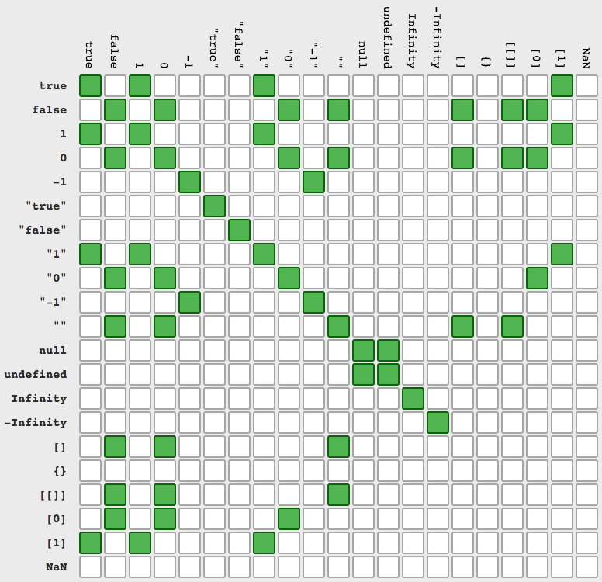

Slide 123
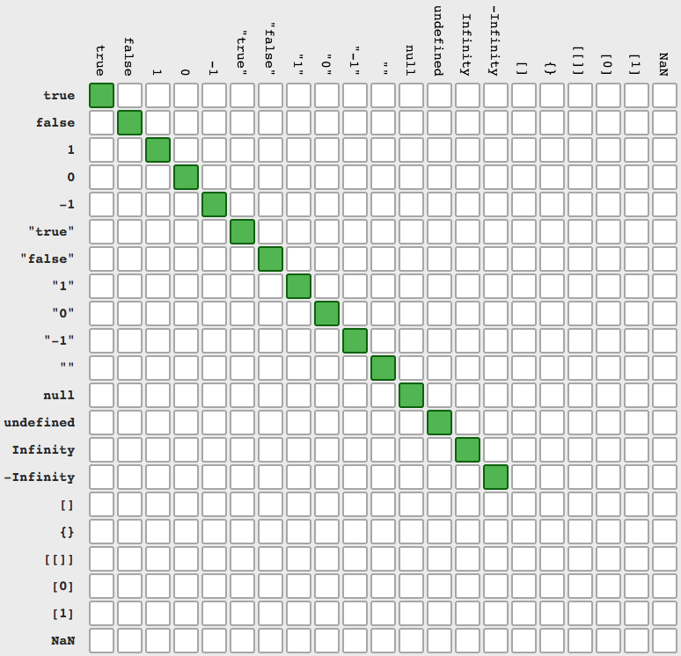

Slide 124
db.collection.update()
Modifies an existing document or documents in a collection. The method can modify specific fields of an existing document or documents or replace an existing document entirely, depending on the update parameter. By default, the update() method updates a single document. Set the Multi Parameter to update all documents that match the query criteria.

Slide 125
db.collection.update()
By default, the update() method updates a single document. Set the multi Parameter to update all documents that match the query criteria, an upsert means an update than inserts a new document if no document matches the filter.
db.collection.update({ query }, { update }, { options })
db.collection.update({ query }, { $set:{ update }}, { options })
Options : { $set: { field: value } }, { multi: true, upsert: true }
db.emp.update({ job: "programmer" }, { job: "sales" }, { upsert: true } )
db.emp.update({ job: "programmer" }, { $set: { job: "sales" } }, { upsert : true, multi: true })
db.emp.update({ ename: "ram" }, { $set : { size: "small", color: [ "red", "blue" ] } }, { multi: true } )

Slide 126
db.emp.updateOne({ sal: { $gt : 2000 } }, { $set: { color : [ "red", "yellow", "green", "blue"] } });
db.emp.updateMany({ sal: { $gt : 2000 } }, { $set: { color : [ "red", "yellow", "green", "blue" ] } });
db.collection.updateOne()
db.collection.updateMany()
updateOne() operations can add fields to existing documents using the $set operator.
updateMany() operations can add fields to existing documents using the $set operator.

Slide 127
db.collection.updateOne()
updateOne() updates a single document within the collection based on the filter. an upsert means an update than inserts a new document if no document matches the filter.
updateMany() updates multiple documents within the collection based on the filter. an upsert means an update than inserts a new document if no document matches the filter.
db.collection.updateOne({ filter }, { $set:{update} }, { options })
db.collection.updateMany({ filter }, { $set:{update} }, { options })
{ $set: { field: value }, { upsert: true }
Note:
The $set operator replaces the value of a field with the specified value.
If the field does not exist, $set will add a new field with the specified value.
If you specify multiple field-value pairs, $set will update or create each field.
To specify a <field> in an embedded document or in an array, use dot notation.

Slide 128
$inc
$inc operator increments a field by a specified value.

Slide 129
$inc
The $inc operator increments a field by a specified value.
{ $inc: { <field1>: <amount1>, <field2>: <amount2>, ... } }
{ $set: { field1: value, field2: value },
{ $inc: { <field1>: <amount1>, <field2>: <amount2>, ... } }
db.emp.updateOne({ sal: { $gt: 300 } }, { $inc: { sal: 1 } });
db.emp.updateOne({ _id: 2 }, { $set: { comm: 111 } }, { $inc: { sal: 1 } });

Slide 130
$unset
$unset operator deletes a particular field.

Slide 131
$unset
The $unset operator deletes a particular field.
{ $unset: { <field1>: "", ... } }
[
{ $set: { field1: value, field2: value },
{ $unset: [ <field1>, <field2>, <field3>, ... ] }
]
db.emp.update({ ename: "saleel" }, { $unset: { comm: 0, ename: '', sal: true }})
db.emp.updateOne({ ename: "saleel" }, { $unset: { comm: 0, ename: '', sal: 0 }})
db.emp.updateMany({ ename: "saleel" }, { $unset: { comm: 0, ename: '', sal: 0 }})
db.emp.updateOne({ _id: 2 }, [ { $set:{ x: 100 }}, { $unset:['name’, 'sal'] }]);

Slide 132
$rename
$rename operator updates the name of a field.

Slide 133
$rename
The $rename operator updates the name of a field.
{ $rename: { <oldfield1>: <newName1>, <oldfield2>: <newName2>, ... } }
db.emp.update({}, { $rename: { "ename": "Employee Name", "sal": "Salary" }})
db.emp.updateOne({}, { $rename: { "ename": "Employee Name", "sal": "Salary" } })
db.emp.updateMany({}, { $rename: { "ename": "Employee Name", "sal": "Salary" } })

Slide 134
array update
{ $push: { <field1>: { field: value, field: value, ... }, ... } }
{ $push: { <field1>: { $each: [value1, value2, ... ], $position: <num> } } }
{ $pop: { <field>: <-1 | 1>, ... } }
{ $pull: { <field1>: <value | condition>, <field2>: <value | condition>, ... } }
{ $pullAll: { <field1>: [ <value1>, <value2> ... ], ... } }
{ $addToSet: { <field1>: <value1>, ... } }
Note:
The $push operator appends a specified value to an array <field>.
The $each with $push operator to append multiple values to an array <field>.
The $pop operator removes the first or last element of an array. Pass value of -1 to remove the first element of an array and 1 to remove the last element in an array.
The $pull operator removes from an existing array all the value or values that match a specified condition.
The $pullAll operator removes all instances of the specified values from an existing array. Unlike the $pull operator that removes elements by specifying a query, $pullAll removes elements that match the listed values.
The $addToSet operator adds a value to an array unless the value is already present, in which case $addToSet does nothing to that array.

Slide 135
array update
{ $push: { <field1>: { field: value, field: value, ... }, ... } }
{ $push: { <field1>: { $each: [value1, value2, ... ], $position: <num> } } }
{ $pop: { <field>: <-1 | 1>, ... } }
{ $pull: { <field1>: <value | condition>, <field2>: <value | condition>, ... } }
{ $pullAll: { <field1>: [ <value1>, <value2> ... ], ... } }
{ $addToSet: { <field1>: <value1>, ... } }
db.books.updateOne({ _id: 1 }, { $set: { publisher: "abc publisher", founded: 1972 } });
db.books.updateOne({ _id: 1 }, { $push: { languages: "french" } });
db.books.updateOne({ _id: 1 }, { $push: { website: { $each: [ "redis.com", "redis.io" ] } } });
db.person.updateOne({}, { $pull: { phone: -333 } });
db.person.updateOne({}, { $pull: {website: { $in: [ "redis.com", "redis.io" ] } } });
db.person.updateOne({}, {$pull: {Rating: { $gt: 6 }}});
db.books.updateOne({ _id: 1 }, { $push: { email: { $each: [ "redis.com", "redis.io" ], $position : 0 } } });

Slide 136
{ $inc: { <field1>: <amount1>, <field2>: <amount2>, ... } }
{ $unset: { <field1>: "", ... } }
{ $rename: { <oldfield1>: <newName1>, <oldfield2>: <newName2>, ... } }
db.collection.findOneAndUpdate()
Updates a single document based on the filter and sort criteria.

Slide 137
db.collection.findOneAndUpdate()
findOneAndUpdate() updates the first matching document in the collection that matches the filter. The sort parameter can be used to influence which document is updated.
db.collection.findOneAndUpdate({ filter }, { update }, { options })
Options
returnDocument : string – [ Optional. Starting, returnDocument is an alternative for
returnDocument: "before" returns the original document.
returnDocument: "after" returns the updated document. ]
returnNewDocument : boolean – [ Optional. When true, returns the updated document instead of the original document. Defaults to false. ]
Note:
returnNewDocument. If both options are set, returnDocument takes precedence.

Slide 138
db.collection.replaceOne()
Replaces a single document within the collection based on the filter.

Slide 139
db.collection.replaceOne()
replaceOne() replaces a single document within the collection based on the filter.
db.collection.replaceOne(filter, replacement, options)
db.emp.replaceOne({ ename: "saleel" }, { x: 500, y: 500 })

Slide 140
db.collection.deleteOne() & db.collection.deleteMany()
Removes a single/multiple document(s) from a collection.

Slide 141
db.collection.deleteOne() db.collection.deleteMany()
deleteOne() removes a single document from a collection. Specify an empty document { } to delete the first document returned in the collection.
deleteMany() removes all documents that match the filter from a collection.
db.collection.deleteOne({ filter })
db.collection.deleteMany({ filter })
db.emp.deleteOne({});
db.emp.deleteOne({ job: "manager" });
db.emp.deleteMany({});
db.emp.deleteMany({ job: "manager" });

Slide 142
db.collection.findOneAndDelete()
Deletes a single document based on the filter and sort criteria, returning the deleted document.

Slide 143
db.collection.findOneAndDelete()
findOneAndDelete() deletes the first matching document in the collection that matches the filter. The sort parameter can be used to influence which document is updated.
db.collection.findOneAndDelete({ filter }, [ { sort },{ projection }])
db.emp.findOneAndDelete({ job: "manager" });
db.emp.findOneAndDelete({ job: "manager" }, { sort: { sal: 1 } });

Slide 144
stages
All stages are independent.
$documents dual table | $match WHERE clause | $project SELECT clause | $addFields ADD New fields | $sample RANDOM document | $unwind PIVOT an array | $group GROUP BY clause
$match HAVING clause | $sort ORDER BY clause | $limit TOP clause | $skip | $unset REMOVE fields from output | $sortByCount | $out NEW Collection
aggregate()
In aggregation, the result of one stage is simply passed to another stage.
db.collection.aggregate( [ { <stage1> }, { <stage2> }, ..., { <stageN> } ] )
db.emp.aggregate([]);

Slide 145
aggregation <stageOperators> and aggregation <expression>
Each sage starts with stage operator.
Each aggregation expression starts with $ sign.
{ $<stageOperator> : { } }
"$<field>"
{ $match : { job: 'manager' } }
{ $group : { _id : '$job' } }
$documents dual table | $match WHERE clause | $project SELECT clause | $addFields ADD New fields | $sample RANDOM document | $unwind PIVOT an array | $group GROUP BY clause
$match HAVING clause | $sort ORDER BY clause | $limit TOP clause | $skip | $unset REMOVE fields from output | $sortByCount | $out NEW Collection

Slide 146
$documents
Returns literal documents from input values.

Slide 147
$documents
Filters the documents to pass only the documents that match the specified condition(s) to the next pipeline stage.
{ $documents: [ { doc₁ }, { doc₂ }, { doc₃ }, ... ] }
db.aggregate([ { $documents: [ { _id: 1001, ename: 'saleel', job: 'salesman' },
{ _id: 1002, ename: 'sharmin', job: "manager" },
{ _id: 1003, ename: 'vrushali', job: "manager" }
]
}
]);

Slide 148
$match
Filters the documents to pass only the documents that match the specified condition(s) to the next pipeline stage.

Slide 149
$match
Filters the documents to pass only the documents that match the specified condition(s) to the next pipeline stage.
{ $match: { <query> } }
db.emp.aggregate([ { $match: { job: "manager" } } ]);
db.emp.aggregate([ { $match: { comm: { $eq: null } } } ]);
db.items.aggregate([ {$match:{ tags:{$in:["A", "K"] } } } ]);
db.items.aggregate([ {$match:{ tags:{$nin:["A", "K"] } } } ]);
db.emp.aggregate([ { $match: { sal: { $gt: 4000 } } }, { $group: { _id: "$job", count: { $sum: "$sal" } } } ]);
db.emp.aggregate([ { $match: { favouriteFruit: { $size: 1 } } } ]);
db.emp.aggregate([ { $match: { 'favouriteFruit.0': "Orange"} }, { $project: { favouriteFruit: true } } ]);

Slide 150
$project
Passes along the documents with the requested fields to the next stage in the pipeline. The specified fields can be existing fields from the input documents or newly computed fields.
<field>: <1 or true> - Specifies the inclusion of a field. Non-zero integers are also treated as true.
_id: <0 or false> - Specifies the suppression of the _id field.
<field>: <expression> - Adds a new field or resets the value of an existing field.
<field>: <0 or false> - Specifies the exclusion of a field.

Slide 151
$project
Passes along the documents with the requested fields to the next stage in the pipeline. The specified fields can be existing fields from the input documents or newly computed fields.
{ $project: { <specification(s)> } }
db.emp.aggregate([ { $project: { ename: true } } ])
db.emp.aggregate([ { $project: { "Employee Name" : "$ename" } } ]) // alias name
db.emp.aggregate([ { $project: { _id: false, sal: true, comm: true } } ])
db.emp.aggregate([ { $project: { sal: true, sm: { $sum: "$sal" } } } ])
db.emp.aggregate([ { $project: { xx: { $max: [ "$sal", "$comm" ] } } } ])
db.emp.aggregate([ { $project: { favouriteFruit: { $size: "$favouriteFruit" }}}])

Slide 152
$unset
Removes/excludes fields from documents in output.

Slide 153
$unset
Removes field(s) from the output. Will not delete the field(s) from the saved document.
{ $unset: "<field>" }
{ $unset: [ "<field1>", "<field2>", ... ] }
{ $unset: "<field.nestedfield>" }
{ $unset: [ "<field1.nestedfield>", ...] }
db.emp.aggregate([ { $unset: "ename" } ])
db.emp.aggregate([ { $unset: "address.building" } ])

Slide 154
$literal
Returns a value without parsing. Use for values that the aggregation pipeline may interpret as an expression.

Slide 155
$literal
To avoid treating numeric or boolean literals as projection flags, use the $literal expression to wrap the numeric or boolean literals.
{ $literal: <value> }
db.emp.aggregate([{ $project: { _id: 0, sal: 1, staticValue: { $literal: 1001 }, staticString: { $literal: "Saleel Bagde" }}}])

Slide 156
Remember:
If the name of the new field is the same as an existing field name (including _id), $addFields overwrites the existing value of that field with the value of the specified expression.
$addFields or $set
Adds new fields to documents. $addFields or $set outputs documents that contain all existing fields from the input documents and newly added fields.
Note:
$addFields appends new fields to existing documents. You can include one or more $addFields stages in an aggregation operation.
The $addFields stage is equivalent to a $project stage that explicitly specifies all existing fields in the input documents and adds the new fields.
If the $addFields stage is specified after $project stage, then all new fields in $addFields stage will be automatically get added in output document, but if it given before $project stage then all the new fields must be exclusively given in the $project stage.

Slide 157
$addFields or $set
TODO
{ $addFields: { <newField>: <expression>, ... } }
{ $set: { <newField>: <expression>, ... } }
db.emp.aggregate([ { $addFields: { NewSalary: 1450 } } ])
db.emp.aggregate([ { $set: { NewSalary: 1450 } } ])
db.emp.aggregate([{ $project: { _id: 0, ename: 1, salary: "$sal", commission: "$comm" } }, { $addFields: { "Gross Salary": { $add: [ "$salary", "$commission" ] } } }])
db.emp.aggregate([{ $project: { _id: false, ename: true, sal: true, x: { $literal: 100 }, y: { $literal: 200 } } }, { $addFields: { z: { $add: [ '$x', '$y' ] } } }])

Slide 158
$expr
$expr can build query expressions that compare fields from the same document in a $match stage.

Slide 159
$expr
TODO
{ $expr: { <operator>: ['$<argument1>' | value1, '$<argument2>' | value2 ] } }
$expr: { $eq: ['$sal', 3000 ] } }
$expr: { $gt: ['$<argument1>' | value1, '$<argument2>' | value2 ] } }
$expr: { $gte: ['$<argument1>' | value1, '$<argument2>' | value2 ] } }
$expr: { $lt: ['$<argument1>' | value1, '$<argument2>' | value2 ] } }
$expr: { $lte: ['$<argument1>' | value1, '$<argument2>' | value2 ] } }
db.emp.aggregate([ { $project: { _id: false, ename: true, sal: true }}, { $match: { $expr: { $gt: [ '$sal', 5000 ] } } } ]);
db.emp.aggregate([ { $project: { _id: false, ename: true, sal: true, x: { $literal: 10 }, y: { $literal: 10 } } }, { $match: { $expr: { $eq: ['$x', '$y'] } } } ]);

Slide 160
$sample
Randomly selects the specified number of documents from its input.

Slide 161
$sample
Randomly selects the specified number of documents from its input.
{ $sample: { size: <positive integer N> } }
db.emp.aggregate([ { $sample: { size: 2 } } ])

Slide 162
$unwind
Deconstructs an array field from the input documents to output a document for each element. Each output document is the input document with the value of the array field replaced by the element.

Slide 163
$unwind
Deconstructs an array field from the input documents to output a document for each element.
{ $unwind: { path: '$<field path>', includeArrayIndex: <string> }
db.emp.aggregate([ { $project: { favouriteColor: true } }, { $unwind: "$favouriteColor" } ])

Slide 164
arithmetic expression operators
db.movies.aggregate([ { $project: { _id: false, "Title": true, R: { $round: { $multiply: [ {$rand: {} }, 800 ] } } } } ])

Slide 165
arithmetic expression operators
Arithmetic expressions perform mathematic operations on numbers. Some arithmetic expressions can also support date arithmetic.
Arithmetic expressions
x: { $abs: '$<number>' }
x: { $add: ['$<expression1>', '$<expression2>', ... ] }
x: { $subtract: ['$<expression1>', '$<expression2>' ] }
x: { $multiply: ['$<expression1>', '$<expression2>', ...] }
x: { $divide: ['$<expression1>', '$<expression2>' ] }
x: { $mod: ['$<expression1>', '$<expression2>' ] }
x: { $round : [ <number>, <place> ] }
x: { $trunc: '$<number>' } x: {{ $round : [ <number>, <place> ] }
x: { $rand:{} }
db.emp.aggregate([ { $project : { op: { $trunc: "$sal" } } } ])
db.emp.aggregate([ { $project: { sal: true, op : { $add: [ "$sal", 1000 ] } } } ])
db.emp.aggregate([ { $project: { x: { $rand: {} } } } ])

Slide 166
$ifNull(), $toUpper, $toLower, $concat, . . .

Slide 167
$ifNull(), $toUpper(), $toLower(), $concat
Evaluates an expression and returns the value of the expression if the expression evaluates to a non-null value. If the expression evaluates to a null value, including instances of undefined values or missing fields, returns the value of the replacement expression.
x: { $ifNull:[ '$<expression>', <replacement-expression-if-null> ] }
x: { $toUpper: '$<expression>' }
x: { $toLower: '$<expression>' }
x: { $strLenCP: '$<expression>' } // string expression
x: { $concat:[ '$<expression1>', '$<expression2>', ... ] }
x: { $substr: [ <string>, <start>, <length> ] }
x: { $size: '$<expression>' }
x: { $arrayElemAt: [ '$<array>', <idx> ] } // -1 will get last element from array
x: { $split: [ '$<expression>', '<delimiter>' ] }
x: { $slice: [ '$<array>' , <position>, <n> ] } ] }

Slide 168
$ifNull(), $toUpper(), $toLower(), $concat
db.emp.aggregate([ { $project: { comm : { $ifNull: [ "$comm", "NA" ] } } } ])
db.emp.aggregate([ { $project: { "Gross Salary": { $add: [ "$sal", { $ifNull: [ "$comm", 0 ] } ] } } } ])
db.emp.aggregate([ { $project: { ename : { $toUpper: "$ename" } } } ])
db.emp.aggregate([ { $project: { ename : { $toLower: "$ename" } } } ])
db.movies.aggregate([ { $project: { movie_title: true, movie_length: { $strLenCP: { $toString: "$movie_title" } } } } ])
db.emp.aggregate([ { $project: { ename : { $concat: [ "$ename", "$job" ] } } ])
db.emp.aggregate([ { $project: { favouriteFruit: { $size: "$favouriteFruit" } } } ])
db.emp.aggregate([ { $project: { op: { $arrayElemAt: [ "$favouriteFruit", 1 ] } } } ])
db.movies.aggregate([ { $project: { _id: false, title: "$movie_title", genres: true, x: { $split: [ "$genres", "|" ] } } }, { $limit: 4 }])
db.emp.aggregate([ { $project: { x: { $arrayElemAt: [ "$favouriteFruit", 1 ] } } }, { $match: { x: 'Orange' } } ])

Slide 169
$toString(), $toInt(), $toDoube(), . . .
TODO
x: { $toString: '$<expression>' }
x: { $toInt: '$<expression>' }
x: { $toDouble: '$<expression>' }
x: { $toLong: '$<expression>' }
x: { $toBool: '$<expression>' }

Slide 170
$type(), $isNumber(), . . .
TODO
x: { $type: '<$expression>' }
x: { $isNumber: '<expression>' } | // true if the expression is number. // false if the expression is any other BSON type, null, or a missing field.
db.movies.aggregate([{ $addFields:{ x: { $type: "$Title" }}}])
db.movies.aggregate([{ $addFields:{ x: { $isNumber: "Title" }}}])
db.movies.aggregate([{ $addFields:{ x: { $type: "$Title" }}},{ $match:{ x:"int" } } ])

Slide 171
$first(), $last(), $range(), $allElementsTrue(), $anyElementTrue(), …
x: { $replaceOne: { input: <expression>, find: <expression>, replacement: <expression> } } x: { $replaceAll: { input: <expression>, find: <expression>, replacement: <expression> } }
x: { $first: '$<expression>' }
x: { $last: '$<expression>' }
x: { $range: [ <start>, '$<expression>', <non-zero step> ] }
x: { $allElementsTrue: '$<expression>' } //in list → [ ]
x: { $anyElementTrue: '$<expression>' } //in list → [ ]
x: { $cond: { if: <boolean-expression>, then: <true-case>, else: <false-case> } }
db.movies.aggregate([{$project:{_id: false, "Title": true, x:{ $replaceAll: { input: { $toString: "$Title" }, find: "T", replacement: "@" }}}}])

Slide 172
$first(), $last(), $range(), $allElementsTrue(), $anyElementTrue(), …
db.emp.aggregate([ { $project: { _id: false, x: { $first: "$cards" } } } ])
db.emp.aggregate([ { $project: { _id: false, x: { $last: "$cards" } } } ])
db.emp.aggregate([ { $project: { "address.coord": true, x: { $last: "$address.coord" } } } ])
db.movies.aggregate([ { $project: { x: { $range: [ 0, { $ifNull: [ "$duration", 0 ] }, 30 ] }} } ])
db.survey.aggregate([ { $project:{ responses: true, x: { $allElementsTrue: "$responses" } } } ])
db.survey.aggregate([ { $project:{ responses: true, x: { $anyElementTrue: "$responses" } } } ])
db.movies.aggregate([ { $match: { movie_title: /Horse/ }}, { $project: { _id: true, movie_title: true, duration: true, x: { $range: [ 0, "$duration", 60 ] } } }])
db.movies.aggregate([ { $project:{ duration: true, x: { $cond: { if: { $eq: [ "$duration", 100 ]}, then: "$duration", else: "More" } } } } ])
db.emp.aggregate([{ $project: { _id: false, ename: true, sal: true, output: { $cond: { if: { $gte: ['$sal', 3000] }, then: { $add: ['$sal', 1000] }, else: '$sal' } } } }])

Slide 173
date operators

Slide 174
date operators
TODO
Date expressions
x: { $dayOfMonth: '$<dateExpression>' }
x: { $dayOfWeek: '$<dateExpression>' }
x: { $dayOfYear: '$<dateExpression>' }
x: { $month: '$<dateExpression>' }
x: { $week: '$<dateExpression>' }
x: { $year: '$<dateExpression>' }
db.emp.aggregate([ { $project: { Day: { $dayOfMonth: "$hiredate" } } } ])
db.emp.aggregate([ { $project: { Month: { $month: "$hiredate" } } } ])
const x = [ 'January', 'February', 'March', 'April', 'May', 'June', 'July', . . . ]

Slide 175
$group
Groups documents by some specified expression and outputs to the next stage a document for each distinct grouping. The output documents contain an _id field which contains the distinct group by key. The output documents can also contain computed fields that hold the values of some accumulator expression grouped by the $group’s _id field. $group does not order its output documents.

Slide 176
$group
The _id field is mandatory; however, you can specify an _id value of null to calculate accumulated values for all the input documents as a whole.
{ $group: { _id: '$<expression>', <field1>: { <accumulator1> : <expression1> }, ... } }
Accumulator Operator - [ $group and $project stage ]
x: { $avg: '$<expression>' }
x: { $sum: '$<expression>' }
x: { $min: '$<expression>' } x: { $min: ['$<expression>', '$<expression>' ... ] }
x: { $max: '$<expression>' } x: { $max: ['$<expression>', '$<expression>' ... ] }
x: { $count: {} }
db.emp.aggregate([ { $group: { _id: null, count: { $sum: 1} } } ])
db.emp.aggregate([ { $group: { _id: null, total: { $sum: "$sal" } } } ])
db.emp.aggregate([ { $group: { _id: "$job", count: { $sum: 1 } } } ])

Slide 177
$group on multiple fields

Slide 178
$ group
The _id field is mandatory; however, you can specify an _id value of null to calculate accumulated values for all the input documents as a whole.
{ $group: { _id: { <field1>: '$<expression>', ... }, <field1>: { <accumulator1> : '$<expression1'> }, ... } }
db.emp.aggregate([ { $group: { _id: { job: "$job", deptno: "$deptno" }, count : { $sum: 1 } } } ])

Slide 179
$sort
Sorts all input documents and returns them to the pipeline in sorted order.

Slide 180
$sort
TODO
{ $sort: { <field1>: <sort order>, <field2>: <sort order> ... } }
db.emp.aggregate([ { $sort: { ename: 1 } } ])
Value | Description
1 | Sort ascending.
-1 | Sort descending.

Slide 181
$sortByCount
The documents are sorted by count in descending order.

Slide 182
$sortByCount
TODO
{ $sortByCount: $<expression> }
db.emp.aggregate([ { $sortByCount : "$job" } ])

Slide 183
$limit
Limits the number of documents passed to the next stage in the pipeline.

Slide 184
$limit
TODO
{ $limit: <positive integer> }
db.emp.aggregate([ { $limit: 2 } ])
db.emp.aggregate([ { $project: { total: { $add: [ "$sal", "$comm" ] } } }, { $limit: 2 } ])

Slide 185
$skip
Skips over the specified number of documents that pass into the stage and passes the remaining documents to the next stage in the pipeline.

Slide 186
$skip
TODO
{ $skip: <positive integer> }
db.emp.aggregate([ { $skip: 2 } ])

Slide 187
$count
Counts the number of documents in a collection or a view.

Slide 188
$count
TODO
{ $count: "Field-name" }
db.emp.aggregate([ { $count: "ename" } ])

Slide 189
$out
Takes the documents returned by the aggregation pipeline and writes them to a specified collection.

Slide 190
$out
Takes the documents returned by the aggregation pipeline and writes them to a specified collection.
{ $out: { db: "<output-db>", coll: "<output-collection>" } }
db.emp.aggregate([ { $project: { movie_title: true, director: true, duration: true } }, { $out: "movieList" } ])
db.emp.aggregate([ { $project: { movie_title: true, director: true, duration: true } }, { $out: { db: "new-db-name"}, coll: "movieList" } ])
Note:
The $out stage must be the last stage in the pipeline.

Slide 191
db.createView()
Views are read-only; write operations on views will error.
Note:
You must create views in the same database as the source collection.
A view definition pipeline cannot include the $out or the $merge stage. This restriction also applies to embedded pipelines, such as pipelines used in $lookup or $facet stages.
You cannot rename a view once it is created.
Views are read-only; write operations on views will error.

Slide 192
db.createView()
Views are read-only; write operations on views will error. You cannot rename views.
db.createView("<viewName>", "<source>", [<pipeline>],
{
"collation" : { <collation> }
}
)
db.createView("empView", "emp", [ { $match: { job: "manager" } } ])
db.createView("employeeView", "emp", [ { $project: { _id: false, ename: true, address: true, job: true, salary: "$sal" } } ])
db.empView.aggregate([ { $match: { empid: 1029 } } ])
db.empView.drop()

Slide 193
db.createIndex()
todo
Note:
todo

Slide 194
db.createIndex()
todo
db.collection.createIndex( <field>, <options> )
Value | Description
1 | specifies an index that orders items in ascending order.
-1 | specifies an index that orders items in descending order..
db.createView("empView", "emp", [ { $match: { job: "manager" } } ])
db.empView.aggregate([ { $match: { empid: 1029 } } ])

Slide 195
$setUnion / $setIntersection
/ $setDifference
Takes two or more arrays and returns an array containing the elements that appear in any input array.
Takes two or more arrays and returns an array that contains the elements that appear in every input array.
Takes two sets and returns an array containing the elements that only exist in the first set.

Slide 196
$setUnion
TODO
{ $setUnion: [ <expression1>, <expression2> ] }

Slide 197
$setIntersection
TODO
{ $setIntersection: [ <expression1>, <expression2> ] }

Slide 198
$setDifference
TODO
{ $setDifference: [ <expression1>, <expression2> ] }

Slide 199
$rank / $denseRank / $documentNumber
todo

Slide 200
$rank / $denseRank / $documentNumber
Returns the document position.
{ $setWindowFields: {
partitionBy: "$Field", </optional>
sortBy: { field: -1/1},
output: { x: { $rank: {} } } OR
output: { x: { $denseRank: {} } } OR
output: { x: { $documentNumber: {} } }
}
}
db.orders.aggregate([{ $setWindowFields: {
sortBy: { _id: 1 },
output: { x: { $documentNumber: {} } }
}}])
Note:
$rank/$denseRank/$documentNumber does not accept any parameters.
$rank/$denseRank/$documentNumber is only available in the $setWindowFields stage.
partitionBy: "$Field" is optional property for $setWindowFields stage.

Slide 201
$rank / $denseRank / $documentNumber
TODO
db.orders.aggregate([ { $setWindowFields:
{
sortBy: { _id: 1 },
output: { x: { $documentNumber: {} }
}
} }]);
db.movies.aggregate([ { $setWindowFields:
{
sortBy: { _id: 1 },
output: { x: { $documentNumber: {} }
},
{ $project: { _id: false, title: '$movie_title', x: true } }, { $match: { x: 3 } }]);

Slide 202
localField: <datatype of field from parent collection must be same>,
foreignField: <datatype of field from child collection must be same>,
$lookup
To perform an equality match between a field from the input documents with a field from the documents of the “joined” collection

Slide 203
$lookup
{
$lookup:
{
from: <foreign collection>,
localField: <field from the input documents>,
foreignField: <field from the documents of the "from" collection>,
as: < text >,
pipeline: [ { $project }, { $match } ]
}
},
{
$lookup:
{
from: <foreign collection>,
localField: <field from the input documents>,
foreignField: <field from the documents of the "from" collection>,
as: < text >,
pipeline: [ { $project }, { $match } ]
}
}

Slide 204
$lookup
db.order.aggregate([{
$lookup: {
from: 'orderdetails',
localField: '_id',
foreignField: 'orderID',
as: 'OrderDetails',
pipeline: [{
$project: {
_id: false,
product: true,
qty: true,
rate: true,
Total: {
$multiply: ['$qty', '$rate']
}
}
}]
}
}])

Slide 205
$lookup
e.g.
TODO
db.orders.insertMany([
{ "orderNo" : 1, "orderDay" : "Mon" },
{ "orderNo" : 2, "orderDay" : "Sat" },
{ "orderNo" : 3 } ])
db.orderdetails.insertMany([
{"orderNo" : 1, "item" : "maggi", "price" : 40, "quantity" : 7 },
{"orderNo" : 1, "item" : "butter", "price" : 125, "quantity" : 12 }, {"orderNo" : 1, "item" : "cheese", "price" : 225, "quantity" : 12 }, {"orderNo" : 2, "item" : "coffee", "price" : 75, "quantity" : 1 },
{"orderNo" : 2, "item" : "tea", "price" : 175, "quantity" : 3 },
{"orderNo" : 2, "item" : "nuts", "price" : 375, "quantity" : 2 } ])
> db.orders.drop()
> db.orderdetails.drop()
> db.orders.find()
> db.orderdetails.find()

Slide 206
$lookup
e.g.
TODO
db.orders.aggregate ([
{ $lookup: {
from : "orderdetails",
localField : "orderNo",
foreignField : "orderNo",
as : "Order Details" }
}]).forEach(printjson);
db.orders.aggregate([
{ $lookup: {
from: "orderdetails",
localField: "orderNo",
foreignField: "orderNo",
as: "Order Details" } },
{ $project:{ _id: false, "Order Details._id": false}}]).forEach(printjson);

Slide 207
Database Security and Authentication
Authentication is the process of verifying the identity of a client. When access control, i.e. authorization, is enabled, MongoDB requires all clients to authenticate themselves in order to determine their access. Although authentication and authorization are closely connected, authentication is distinct from authorization. Authentication verifies the identity of a user; authorization determines the verified user’s access to resources and operations.

Slide 208
db.getUser() / db.getUsers()

Slide 209
db.getUser() / db.getUsers()
Returns user information for a specified user.
db.getUser(username, args)
db.getUser("user01");
Returns information for all the users in the database.
db.getUsers()
db.getUsers();

Slide 210
db.createUser

Slide 211
db.createUser
Creates a new user for the database on which the method is run. db.createUser() returns a duplicate user error if the user already exists on the database.
db.createUser(user, [writeConcern])
db.createUser (
{
user: "user01",
pwd: "user01",
roles:[{role: "userAdmin" , db: "db1"},
{role: "readWrite", db: "db1"}],
authenticationRestrictions: [ {
clientSource: [ "192.168.100.26", "192.168.100.20", "192.168.100.120",
"192.168.100.83"],
serverAddress: ["192.168.100.20"]
} ]
});

Slide 212
db.grantRolesToUser / db.revokeRolesFromUser

Slide 213
db.grantRolesToUser
db.revokeRolesFromUser
TODO
db.grantRolesToUser( "<username>", [ <roles> ], { <writeConcern> }
db.grantRolesToUser( "user01",
[
{ role: "read", db: "db1" }
]
);
db.revokeRolesFromUser("<username>", [<roles>], {<writeConcern>} )
db.revokeRolesFromUser( "user01",
[
{ role: "read", db: "db1" }
]
);

Slide 214
roles
The role provides the following actions on those collections
Read :- [dbStats, find, listIndexes, listCollections, etc...]
readWrite :- [collStats, convertToCapped, createCollection, dbHash, dbStats, dropCollection, createIndex, dropIndex, find, insert, killCursors, listIndexes, listCollections, remove, renameCollectionSameDB, update]
userAdmin :- [TODO]
readAnyDatabase :- [TODO]
readWriteAnyDatabase :- [TODO]

Slide 215
db.dropAllUser() / db.dropUser()

Slide 216
db.dropUser() / db.dropAllUsers()
Removes the user from the current database.
db.dropUser(username, writeConcern)
db.dropUser("user01");
Removes all users from the current database.
db.dropAllUsers([writeConcern])
db.dropAllUser();

Slide 217
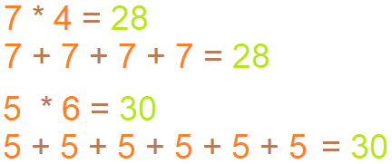
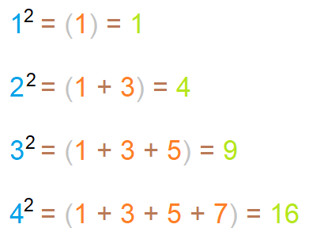
IMP
1. Think about how multiplication can be done without actually multiplying
2. Square

Slide 218
IMP
Camel Case: Second and subsequent words are capitalized, to make word boundaries easier to see.
Example: numberOfCollegeGraduates
Pascal Case: Identical to Camel Case, except the first word is also capitalized.
Example: NumberOfCollegeGraduates
Snake Case: Words are separated by underscores.
Example: number_of_college_graduates

Slide 219
IMP
Types of Machine Learning (Supervised, Un-Supervised, Reinforcement)

Slide 220

Supervised Learning
Supervised machine learning has two key components: first is input data and second corresponding output labels. The goal is to build a model that can learn from this labeled data to make predictions or classifications on new, unseen data.
The labeled data consists of input features and the corresponding output labels.

Slide 221
Supervised Learning
Medical Diagnosis: Supervised algorithms are also used in the medical field for diagnosis purposes. It is done by using medical images and past labelled data with labels for disease conditions. With such a process, the machine can identify a disease for the new patients.
Fraud Detection - Supervised Learning algorithms are used for identifying fraud transactions, fraud customers, etc. It is done by using historic data to identify the patterns that can lead to possible fraud.
Spam detection - In spam detection & filtering algorithms are used. These algorithms classify an email as spam or not spam. The spam emails are sent to the spam folder.

Slide 222
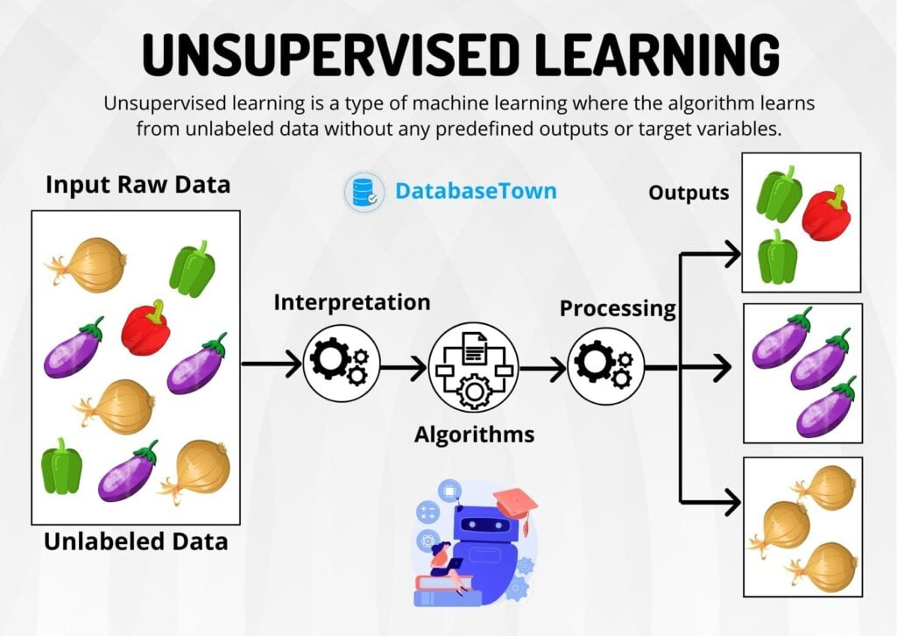
Unsupervised Learning
Unsupervised learning is a type of machine learning where the algorithm learns from unlabeled data without any predefined outputs or target variables. The unsupervised learning finds patterns, similarities, or groupings within the data to get insights and make data-driven decisions.

Slide 223

“Accept your past without regret, handle our present with confidence and face your future without fear.“
A.P.J. Abdul Kalam

Slide 224
array operations in mongodb examples

Slide 225
array operation on student collection
db.student.drop();
db.student.insertMany([{
_id: 1,
name: "saleel",
hobbies: [],
qualifications: [{
name: "10th", grade: "A", year: 1980
}]
}, {
_id: 2,
name: "sharmin",
hobbies: [ "painting" ],
qualifications: [{
name: "10th", grade: "A+", year: 2017
}, {
name: "12th", grade: "A+", year: 2019
}]
}]);

Slide 226
operation on student collection
Add new student with following fields (_id, name, hobbies, city, and state) in the student collection.
db.student.insertOne( { _id: 3, name: "ruhan", hobbies: [ "painting" ], city: "pune", state: "MH" })
Add a grade, year, school, and fees of 10th standard in the qualification field for student _id:3.
db.student.updateOne( { _id: 3 }, { $set: { qualification: [ { name: "10th", grade: "B+", year: 2017, school: "mit", fees: 19000 } ] } })
Add a grade, year, school, and fees of 12th standard in the qualification field for student _id:3.
db.student.updateOne( { _id: 3 }, { $push: { qualification: [ { name: "12th", grade: "A", year: 2019, school: "mit", fees: 22000 } ] } })

Slide 227
operation on student collection
This query is related to the previous example. In the previous example the 12th standard details is added as an array in the qualification field.
See the output of previous example:- db.student.aggregate()
Delete the 12th standard qualification from student collection whose _id:3
db.student.updateOne( { _id: 3 }, { $pop: { "qualification": 1 } })
Add a grade, year, school, and fees of 12th standard in the qualification field whose student _id:3.
db.student.updateOne( { _id: 3 }, { $push: { qualification: { name: "12th", grade: "A", year: 2019, school: "mit", fees: 22000 } } })
Add emailID field to 10th std. and 12th std. school in the student collection whose student _id:3.
db.student.updateOne( { _id: 3 }, { $set: { "qualification.0.emailID": "mit@gmail.com", "qualification.1.emailID": "meer@gmail.com" } })

Slide 228
array operation on student collection
Display the following fields from student collection { _id, student name, hobbies, and count the number of hobbies for every student and show the count in the field hobbyCount }.
db.student.aggregate([ { $project: { _id: true, name: true, hobbies: true, hobbyCount: { $size:"$hobbies" } } } ])
Display the following fields from student collection { _id, student name, city, state, and qualification details of only 10th std.
db.student.aggregate([ { $project: { _id: true, name: true, city: true, state: true, "10th details": { $arrayElemAt: [ '$qualification', 0 ] } } } ])

Slide 229
array operation on student collection

Slide 230
array operation on student collection

Slide 231
array operation on student collection
Add city field for student _id:1
db.student.updateOne( {_id: 1}, { $set: { city: "pune" } } )
Rename qualifications field to qualification for all the documents.
db.student.updateMany( {}, { $rename: { "qualifications": "qualification" } } )
Add new school field to zeroth element of qualification field for student _id:2.
db.student.updateOne( {_id: 2}, { $set: { "qualification.0.school": "rosary" } } )
Add new school field and empty array for emailID field to zeroth element of qualification field for student _id:1.
db.student.updateOne( {_id: 1}, { $set: { "qualification.0.school": "MIT", "qualification.0.emailID": [ ] } } )
Add new value to an empty array for emailID field
db.student.updateOne( {_id: 1}, { $set: { "qualification.0.emailID": "ruhan@gmail.com" } } )

Slide 232
array operation on student collection
Add new value to an empty array for emailID field
db.student.updateOne( {_id: 1}, { $set: { "qualification.0.emailID": [ "sharmin@gmail.com" ] } } )
Add new value to an empty array for emailID field to zeroth element of qualification field for student _id:1.
db.student.updateOne( {_id: 1}, { $push: { "qualification.0.emailID": "saleel@gmail.com" } } )
Add new value to an empty array for emailID field to zeroth element of qualification field for student _id:1.
db.student.updateOne( {_id: 1}, { $push: { "qualification.0.emailID": "sharmin@gmail.com" } } )
Display student name and his 12th qualification details for all students.
db.student.aggregate([ { $project: { _id: 0, name: true, 'qualification details': { $arrayElemAt: [ '$qualification', 1 ] } } } ])

Slide 233
array operation on student collection
Add 12th qualification details for student whose _id:1.
db.student.updateOne( {_id: 1}, { $push: { qualification: { name: "12th", grade: 'B+', year: 1982 } } } )
Add school field in qualification field for both elements.
db.student.updateOne( {_id: 1}, { $set: { 'qualification.0.school': "navrachana", 'qualification.1.school': "bhavance" } } )
Add emailID for each school for student whose _id:1.
db.student.updateOne( {_id: 1}, { $set: { 'qualification.0.emailID': [ "nvrachana@gmail.com" ], 'qualification.1.emailID’: [ "bhavance@gmail.com" ] } } )
Add fees field with value 7000 for all student who are in 10th std.
db.student.updateMany( { 'qualification.name': "10th" }, { $set: { 'qualification.0.fees': 7000 } } )

Slide 234
array operation on student collection
Add football and cricket hobbies whose student _id:1.
db.student.updateOne( {_id: 1}, { $push: { hobbies: { $each: [ "football", "cricket" ] } } } )
Increase the fees by Rs. 2000 of all student who are in 10th std.
db.student.updateMany( { 'qualification.name': "10th" }, { $inc: { 'qualification.0.fees': 2000 } } )
Add new student.
db.student.insertOne( {_id: 3, name: "sangita", hobbies: [], city: "baroda", state: "GJ" } )
Change the name to 'ruhan' whose _id:3.
db.student.updateOne( {_id: 3}, { $set: { name: "ruhan" } } )
Display all students where name starts with the letter 'r’.
db.student.aggregate( [ { $match: { name: /^r/ } } ] )

Slide 235
array operation on student collection
Print student name, hobbies and the first hobby for all the student (using $first).
db.student.aggregate([ { $project: { _id: false, name: true, hobbies: true, firstHobby: { $first: "$hobbies" } } } ])
Print student name, hobbies and the first hobby for all the student (using arrayElemAt).
db.student.aggregate([ { $project: { _id: false, name: true, hobbies: true, firstHobby: { $arrayElemAt: [ "$hobbies", 0 ] } } } ])
Print student name, hobbies and the last hobby for all the student (using $last).
db.student.aggregate([ { $project: { _id: false, name: true, hobbies: true, lasttHobby: { $last: "$hobbies" } } } ])
Print student name, hobbies and the last hobby for all the student (using arrayElemAt).
db.student.aggregate([ { $project: { _id: false, name: true, hobbies: true, lastHobby: { $arrayElemAt: [ "$hobbies", -1 ] } } } ])

Slide 236
array operation on student collection
todo
todo
todo
todo
todo

Slide 237
some operations on emp collection

Slide 238
operation on emp collection
Print all documents from emp collection.
db.emp.aggregate()
Print employee name and the zeroth element of his favourite color.
db.emp.aggregate([ { $project: { _id: false, ename: true, color: { $arrayElemAt: [ '$color', 0 ] } } } ])
Print all fields {_id, ename, gender, address, and isDocActive } from emp collection whose gender is ‘male’ and isDocActive is true for all the employees.
db.emp.aggregate([ { $match: { gender: "male", isDocActive: true } }, { $project: { _id: false, ename: true, gender: true, address: true, isDocActive: true } } ])
Print entire document of the 7th employee.)
db.emp.find()[6]; (Note:- This will not work in mongosh shell)
Count total documents of emp collection.
db.emp.countDocuments({})

Slide 239
operation on emp collection
Count all isDocActive document.
db.emp.countDocuments({isDocActive: true})
Print the last document from emp collection.
db.emp.find()[ db.emp.countDocuments({}) -1 ]
Print the sum of salary for all employees.
db.emp.aggregate([ { $group: { _id: null, totalSalary: { $sum: "$sal" } } } ])
Print random 3 {employee name, address and salary} from emp collection.
db.emp.aggregate([ { $sample: {size: 3 } } ,{ $project: { _id: false, ename: true, address: true, sal: true } } ])
Print first 7 employee name, sal, and comm by changing the heading as Employee Name, Salary and Commission
db.emp.aggregate([ { $project: { _id: false, "Employee Name": "$ename", Salary: "sal", Commission: "$comm" } }, { $limit: 7 } ])

Slide 240
operation on emp collection
Print highest paid salary.
db.emp.aggregate([ { $group: { _id: null, "Maximum Salary" : { $max: '$sal' } } }, { $project: { _id: false } } ])
Print employee name, his salary and also give documentNumber to every document.
db.emp.aggregate([ { $setWindowFields: { sortBy: { sal: -1 }, output: { documentNumber: { $documentNumber: {} } } } }, { $project: { _id: false, ename: true, sal: true, documentNumber: true } }])
Give the ranking to all document in descending order on salary field
db.emp.aggregate([ { $setWindowFields: { sortBy: { sal: -1 }, output: { documentNumber: { $documentNumber: {} } } } }, { $project: { _id: false, ename: true, sal: true, documentNumber: true } }])
Print the document who is getting 3rd highest salary.
db.emp.aggregate([ { $setWindowFields: { sortBy: { sal: -1 }, output: { denseRank: { $denseRank: {} } } } }, { $match: { denseRank: 3 } }, { $project: { _id: false, ename: true, sal: true, denseRank: true } } ])

Slide 241
operation on emp collection
Print the first element from cards array field from emp collection.
db.emp.aggregate([ { $match: { _id: ObjectId("62bfd2ff6a923392ce172cb8") } }, { $project: { _id: true, ename: true, x: { $first: "$cards" } } } ]);
Print the last element from cards array field from emp collection.
db.emp.aggregate([ { $match: { _id: ObjectId("62bfd2ff6a923392ce172cb8") } }, { $project: { _id: true, ename: true, x: { $last: "$cards" } } } ]);
todo
todo
todo

Slide 242
operation on emp collection
todo
todo
todo
todo
todo

Slide 243
some operations on movie collection

Slide 244
operation on movies collection
Import movies.csv file in
mongoimport --host=192.168.1.21 --port=27017 --db=assignment --collection=movies --type=csv --file=d:\movie.csv --headerline --useArrayIndexFields
Print movie_title, director, relese date, and genres whose director name starts with the letter ‘D’.
db.movies.aggregate([ { $match: { director: /^D/ } }, { $project: { movie_title: true, director: true, relese: true, genres: true } } ])
Print movie_title, director, genres, color, week1, week2, week3, week4, and create Total virtual field that print the addition of week1 + week2 + week3 + week4, round the Total to 3 decimal places.
db.movies.aggregate([ { $project: { movie_title: true, director: true, genres: true, color: true, week1: true, week2: true, week3: true, week4: true } }, { $addFields: { Total: { $round: [ { $add: [ '$week1', '$week2', '$week3', '$week4' ] }, 3 ] } } } ])

Slide 245
operation on movies collection
Print movie_title, director, language, genres, and color of all ‘English’ language movies.
db.movies.aggregate([ { $match: { language: "English" } }, { $project: { movie_title: true, director: true, language: true, genres: true, color: true } } ])
Count ‘Hindi’ movies.
db.movies.aggregate([ { $match: { language: "Hindi" } }, { $count: "Total Hindi Movies" } ])
Print color, director, duration, genres, movie_title, title_year, productionhouses where genres is ‘Horror’.
db.movies.aggregate([ { $match: { genres: /Horror/ } }, { $project: { color: true, director: true, duration: true, genres: true, movie_title: true, title_year: true, productionhouses: true } } ])
Create a copy of emp collection from primaryDB collection to assignment collection
db.getSiblingDB('primaryDB').getCollection('emp').aggregate([{ $out: { db: "assignment", coll: "emp" } }])

Slide 246
operation on movies collection
Count languages wise movies.
db.movies.aggregate([ { $group: { _id: '$language' , count : { $sum: 1 } } } ])
Print movie_title, director, genres, actor_1_name, actor_2_name, actor_3_name, budget, gross, stars and add new virtual field Rating and compute total sum of stars.
db.movies.aggregate([ { $project: { movie_title: true, director: true, genres: true, actor_1_name: true, actor_2_name: true, actor_3_name: true, budget: true, gross: true, stars: true } }, { $addFields: { Rating: { $sum: ['$stars'] } } } ])
Split genres in array and print the first element from the array.
db.movies.aggregate([ { $project: { _id: false, title: "$movie_title", genres: true, x: { $split: [ "$genres", "|" ] } } }, { $addFields: { y: { $arrayElemAt: [ "$x", 0 ] } } } ])
Print actor one and count how many characters are there in their name.
db.movies.aggregate([ { $project: { "actor name and length": { $concat: [ "$actor_1_name", " ---> ", { $toString: { $strLenCP: "$actor_1_name" } } ] } } } ])

Slide 247
operation on movies collection
Count movies which is directed by director whose name starts with a letter ‘B’.
db.movies.aggregate([ { $match: { director: /^B/ } }, { $group: { _id: null, count: { $sum: 1 } } } ]);
Print movie title and rating count.
db.movies.aggregate([ { $project: { _id: false, title: "$movie_title", rating : { $concat: [ { $toString: { $sum: '$stars' } } , ' star' ] } } } ])
Print movie list whose rating is = ‘5 star’
db.movies.aggregate([ { $project: { _id: false, title: "$movie_title", stars: true, rating : { $concat: [ { $toString: { $sum: '$stars' } }, ' star' ] } } }, { $match: { rating: '5 star' } } ])
todo

Slide 248
operation on movies collection
todo
todo
todo
todo
todo

Slide 249
operation on movies collection
todo
todo
todo
todo
todo

Slide 250
one-to-one and one-to-many relationship

Slide 251
operation on one-to-one and one-to-many collection
Create one-to-many relation between order and orderitems collection.
Create order collection with following fields [ _id, orderDate, customer, city, latitude, and longitude ]. Insert minimum 7 customer details in the order collection.
Create orderitems collection with following fields [ _id, orderid, cart [ { item, price, quantity, and unit },{item, price, quantity, and unit }, ... ], Insert minimum 3-4 items in cart for every customer.
Create one-to-one relation between driver and licence collection.
Create driver collection with the following fields [ _id, name, age, city, phone ]. Insert 4-5 driver details in the collection.
Create licence collection with the following fields [ _id, driverId, licenceNumber, issuedOn, expireOn ]. Insert licence details for all the drivers.

Slide 252
operation on one-to-one and one-to-many collection
Display all order details with their orderItems details.
db.orders.aggregate([ { $lookup: { from: "orderitems", localField: "_id", foreignField: "orderid", as: "Cart Details" } } ])
Display all order details with their orderItems details whose customer name is ‘ruhan’.
db.orders.aggregate([ { $match: { customer: "ruhan" } }, { $lookup: { from: "orderitems", localField: "_id", foreignField: "orderid", as: "Cart Details" } } ])
Display all drivers with their licence details.
db.driver.aggregate([ { $lookup: { from: "licence", localField: "_id", foreignField: "_id", as: "Licence Details" } } ])
Display all drivers details and their licence number, issuedOn, expireOn only.
db.driver.aggregate([{ $lookup: { from: "licence", localField: "_id", foreignField: "_id", as: "Licence Details" } }, { $project: { _id: true, name: true, 'Licence Details.licenceNumber': true } }])

Slide 253
operation on one-to-one and one-to-many collection
Rename field name to driverName in driver collection.
db.driver.updateOne( { }, { $rename: { name: "driverName" } } )

Slide 254
var x = "Saleel bagde";
console.log(`The value of x is ${x}`);
javascript examples

Slide 255
javascript
some operation on movies collection
Write a javascript program to print documents from emp collection between the range of numbers.
const fn = (a = 0, b = 1) => { return db.emp.aggregate([ { $skip: a }, { $limit: b } ]); };
Print all employee names in title case.
const fn = () => { return db.emp.aggregate([ { $project: { _id: false, ename: true, TitleCaseName: { $concat: [ { $toUpper: { $substr: [ '$ename', 0, 1 ] } }, { $substr: [ '$ename', 1, -1 ] } ] } } } ]); };

Slide 256
javascript
some operation on movies collection
Print the document who is getting the highest salary.
const fn = () => { db.emp.aggregate([{ $group: { _id: null, Salary: { $max: '$sal' } } }]).forEach((doc) => { console.log(db.emp.aggregate([ { $match: { sal: doc.Salary } } ])); }); };

Slide 257
javascript
some operation on movies collection
Write a javascript program to print documents from emp collection who is getting the 3rd highest salary.
const fn = () => { return db.emp.aggregate([{ $setWindowFields: { sortBy: { sal: -1 }, output: { DenseRank: { $denseRank: {} } } } }]).forEach(doc => { if (doc.DenseRank == 3) { console.log(doc.ename, " ", doc.sal, " ", doc.DenseRank); } }); }

Slide 258
javascript
some operation on movies collection
TODO
const fn = () => { db.emp.aggregate([{ $project: { _id: false, ename: true } }]).forEach((doc) => { var x = ""; for (let i = 0; i < doc.ename.length; i++) { x = x + doc.ename.substr(i, 1) + "-"; } console.log(x.substr(0, x.length - 1)) }); }

Slide 259
var x = "Saleel bagde";
console.log(`The value of x is ${x}`);
javascript-mongodb examples

Slide 260
javascript operation on collection
some operation on movies collection
Write a javascript program to insert new driver in drive collection.
let addDriver = (_id, driverName, age, city, phone) => { db.driver.insertOne({ _id: _id, driverName: driverName, age: age, city: city, phone: phone }); };

Slide 261
javascript operation on collection
some operation on movies collection
Write a javascript program to insert new driver in drive collection with multiple phone numbers.
let addDriver = (_id, driverName, age, city, ...phone) => { db.driver.insertOne({ _id: _id, driverName: driverName, age: age, city: city, phone: phone }); };
Enterprise assignment> addDriver( 'driver001', 'Sanjay', 21, 'pune', 9850, 9922, 8080 );

Slide 262
javascript operation on collection
some operation on movies collection
Write a javascript program to insert new driver who must be above or equals to 18 yrs. in drive collection.
let addDriver_above18 = (_id, driverName, age, city, phone) => { if ( age >= 18 ) { db.driver.insertOne({ _id: _id, driverName: driverName, age: age, city: city, phone: phone }); } else { print("Age of driver must be more or equals to 18 yrs."); } };

Slide 263
javascript operation on collection
some operation on movies collection
Write a javascript program to insert new driver in drive collection, the driverId must be auto_increment number. [ e.g. _id: ‘driver1’, ‘driver2’, ‘driver3’, ... ]
let generateDriverID = (driverName, age, city, phone) => { let cnt = db.driver.find().count() + 1; db.driver.insertOne({ _id: "driver" + cnt, driverName: driverName, age: age, city: city, phone: phone }); };

Slide 264
javascript operation on collection
some operation on movies collection
Write a javascript program to accept the number from user and print only those number of documents from movie collection.
let displayFirst_Movies = (x) => { return (db.movies.aggregate([ { $project: { _id: false, director: true, movie_title: true, gross: true, music: true, title_year: true, genres: true } }, { $limit: x } ]) ); };

Slide 265
javascript operation on collection
some operation on movies collection
TODO

Slide 266
javascript operation on collection
some operation on movies collection
TODO

Slide 267
javascript operation on collection
some operation on movies collection
TODO

Slide 268
var x = "Saleel bagde";
console.log(`The value of x is ${x}`);
package.json
"main": "app.js"
C:\Users\Admin\Desktop\JS> cls; node .\app.js OR node .
Node.js-mongodb examples

Slide 269
mongoimport movie.csv collection
some operation on movies collection
Write a program to import movies.csv file using Node.js
import { exec } from 'child_process';
exec('mongoimport --host=192.168.100.91 --port=27017 --db="db1" --collection="movies" --type="csv"
--file="C:/data/movie.csv" --headerline', (err, res) => {
if (err) {
console.log("Some error occurred");
}
else {
console.log("movie documents imported!");
}
});

Slide 270
createCollection()
some operation on movies collection
Write a program to create collection using Node.js
import { MongoClient } from "mongodb";
const client = new MongoClient("mongodb://192.168.100.91:27017");
async function run() {
try {
await client.connect();
const database = client.db("db1");
await database.createCollection("employee");
console.log("Collection created...");
} catch (error) {
console.log(error.code, error.name, error.message);
}
finally{
await client.close();
console.log("Client connection closed");
}
};
run();

Slide 271
capped collection
some operation on movies collection
Write a program to create collection “doctor” with capped, size, and max using Node.js
import { MongoClient } from "mongodb";
const client = new MongoClient("mongodb://192.168.100.91:27017");
async function run() {
try {
await client.connect();
const database = client.db("db1");
await database.createCollection("doctor", { capped: true, size: 100, max: 2 })
console.log("Collection created...");
} catch (error) {
console.log(error.code, error.name, error.message);
}
finally {
await client.close();
console.log("Client connection closed...")
}
};
run();

Slide 272
listCollections()
some operation on movies collection
Write a program to print all the collection from ‘db1’ database using Node.js
import { MongoClient } from "mongodb";
const client = new MongoClient("mongodb://192.168.100.91:27017");
async function run() {
try {
await client.connect();
const database = client.db("db1");
const cursor = database.listCollections();
for await (const doc of cursor) {
console.log(doc.name);
}
console.log("Collection created...");
} catch (error) {
console.log(error.code, error.name, error.message);
}
finally {
await client.close();
console.log("Client connection closed");
}
};
run();

Slide 273
listCollections() using Array()
some operation on movies collection
Write a program to print all the collection from ‘db1’ database using Node.js
import { MongoClient } from "mongodb";
const client = new MongoClient("mongodb://192.168.100.91:27017");
async function run() {
try {
let arr = new Array();
await client.connect();
const database = client.db("db1");
const cursor = database.listCollections();
for await(const doc of cursor) {
arr.push(doc.name);
}
console.log(arr);
} catch (error) {
console.log(error.code, error.name, error.message);
}
finally {
await client.close();
}
};
run();

Slide 274
for (… of) loops
import { MongoClient } from "mongodb";
const client = new MongoClient("mongodb://192.168.100.91:27017");
async function run() {
try {
let arr = new Array();
await client.connect();
const database = client.db("db1");
const cursor = database.listCollections();
for await(const doc of cursor) {
arr.push(doc.name);
}
console.log(arr);
} catch (error) {
console.log(error.code, error.name, error.message);
}
finally {
await client.close();
console.log("Client connection closed");
}
};
run();

Slide 275
array.forEach() loops
import { MongoClient } from "mongodb";
const client = new MongoClient("mongodb://192.168.100.91:27017");
async function run() {
try {
let arr = new Array();
await client.connect();
const database = client.db("db1");
const cursor = database.listCollections();
for await(const doc of cursor) {
arr.push(doc.name);
}
arr.forEach((value, index) => {
console.log(index + value);
});
} catch (error) {
console.log(error.code, error.name, error.message);
}
finally {
await client.close();
}
};
run();

Slide 276
for (… in) loops
import { MongoClient } from "mongodb";
const client = new MongoClient("mongodb://192.168.100.91:27017");
async function run() {
try {
let arr = new Array();
await client.connect();
const database = client.db("db1");
const cursor = database.listCollections();
for await(const doc of cursor) {
arr.push(doc.name);
}
for (const key in arr) {
console.log(arr[key];);
}
} catch (error) {
console.log(error.code, error.name, error.message);
}
finally {
await client.close();
}
};
run();

Slide 277
createCollection() and add new document
some operation on movies collection
Write a program to create collection and add new document using Node.js
import { MongoClient } from "mongodb";
const client = new MongoClient("mongodb://192.168.100.91:27017");
async function run() {
try {
await client.connect();
const database = client.db("db1");
await database.createCollection("person");
const p = database.collection("person");
await p.insertOne({_id:1, ename:'saleel'})
} catch (error) {
console.log(error.code, error.name, error.message);
}
finally {
await client.close();
}
}
run();

Slide 278
renameCollection()
some operation on movies collection
Write a program to rename collection using Node.js
import { MongoClient } from "mongodb";
const client = new MongoClient("mongodb://192.168.100.91:27017");
async function run() {
try {
await client.connect();
const database = client.db("db1");
const p = database.collection("person");
await p.rename("newPerson");
} catch (error) {
console.log(error.message);
}
finally {
await client.close();
}
}
run();

Slide 279
dropCollection()
some operation on movies collection
Write a program to drop collection using Node.js
import { MongoClient } from "mongodb";
const client = new MongoClient("mongodb://192.168.100.91:27017");
async function run() {
try {
await client.connect();
const database = client.db("db1");
const p = database.collection("person");
await p.drop();
} catch (error) {
console.log(error.message);
}
finally {
await client.close();
}
}
run();

Slide 280
insertOne({ })
some operation on movies collection
Write a program to insert single document in ‘movies’ collection using Node.js
import { MongoClient } from "mongodb";
const client = new MongoClient("mongodb://192.168.100.91:27017");
async function run() {
try {
await client.connect();
const database = client.db("db1");
const m = database.collection("movies");
await m.insertOne({ _id: 1, title: "DON" });
console.log("Single document inserted...");
} catch (error) {
console.error(error.code, error.name, error.message);
}
finally {
await client.close();
console.log("Client connection closed...");
}
}
run();

Slide 281
insertOne({ })
Write a program to get the values from the user and insert single document in ‘movies’ collection using Node.js
import { MongoClient } from "mongodb";
const client = new MongoClient("mongodb://192.168.100.91:27017");
async function run(id, relese, color, director, title, gross) {
try {
await client.connect();
const database = client.db("db1");
const e = database.collection("movies");
await e.insertOne({_id:id, relese:relese, color:color, director:director, title:title, gross:gross });
console.log("One document inserted...");
} catch (error) {
console.log(error.code, error.name, error.message);
}
finally{
await client.close();
console.log("Client connection closed");
}
};
run(1, '11-05-1978', 'Color', 'Chandra Barot', 'DON', 450000);

Slide 282
insertOne({ })
Write a program to get the values from the user and insert single document in ‘movies’ collection using Node.js Note:- _id must be auto generated max() + 1
import { MongoClient } from "mongodb";
const client = new MongoClient("mongodb://192.168.100.91:27017");
async function run(relese, color, director, title, gross) {
try {
const database = client.db("db1");
const e = database.collection("movies");
let cnt = 0;
const cursor = e.aggregate([{ $group: { _id: null, x :{ $max:"$_id" } }}]);
for await (const doc of cursor) {
cnt = doc.x + 1;
}
await e.insertOne({_id: cnt, relese:relese, color:color, director:director, title:title, gross:gross});
} catch (error) {
console.log(error.code, error.name, error.message);
}
finally {
await client.close();
console.log("Client connection closed...")
}
};
run('11-05-1978', 'Color', 'Chandra Barot', 'DON', 450000);

Slide 283
insertOne( { } ) using arrow function
some operation on movies collection
Write a program to get the values from the user and insert single document in ‘movies’ collection using Node.js
import { MongoClient } from "mongodb";
const client = new MongoClient("mongodb://192.168.100.91:27017");
const run = async (id, relese, color, director, title, gross) => {
try {
await client.connect();
const database = client.db("db1");
const e = database.collection("movies");
await e.insertOne({_id:id, relese:relese, color:color, director:director, title:title, gross:gross });
console.log("One document inserted...");
} catch (error) {
console.log(error.code, error.name, error.message);
}
finally{
await client.close();
console.log("Client connection closed");
}
};
run(3, '11-05-1978', 'Color', 'Chandra Barot', 'DON', 450000);

Slide 284
insertMany([ { }, { } ])
some operation on movies collection
Write a program to insert multiple document in ‘movies’ collection using Node.js
import { MongoClient } from "mongodb";
const client = new MongoClient("mongodb://192.168.100.91:27017");
async function run() {
try {
await client.connect();
const database = client.db("db1");
const m = database.collection("movies");
await m.insertMany([{_id: 1, title: "DON"}, {_id: 2, title: "Trishul"}]);
console.log("Multiple document inserted...");
} catch (error) {
console.error(error.code, error.name, error.message);
}
finally {
await client.close();
console.log("Client connection closed...");
}
}
run();

Slide 285
find( { }, { })
some operation on movies collection
Write a program to fetch first document from the ‘movies’ collection using Node.js
import { MongoClient } from "mongodb";
const client = new MongoClient("mongodb://192.168.100.91:27017");
async function run() {
try {
await client.connect();
const database = client.db("db1");
const m = database.collection("movies");
const cursor = m.find({}, {});
for await(const doc of cursor) {
console.log(doc);
}
} catch (error) {
console.log(error.code, error.name, error.message);
}
finally {
await client.close();
}
}
run();

Slide 286
find( { }, { projection })
some operation on movies collection
Write a program to fetch first document from the ‘movies’ collection, give alias name to movie_title field using Node.js
import { MongoClient } from "mongodb";
const client = new MongoClient("mongodb://192.168.100.91:27017");
async function run() {
try {
await client.connect();
const database = client.db("db1");
const movie = database.collection("movies");
const cursor = movie.find({}, { projection: { _id: false, Title: '$movie_title' } });
for await (const doc of cursor) {
console.log(doc);
}
} catch (error) {
console.log(error.code, error.name, error.message);
}
finally {
await client.close();
console.log("Client connection closed...");
}
}
run();

Slide 287
runtime collectionName and fieldNames
some operation on movies collection
import { MongoClient } from "mongodb";
const client = new MongoClient("mongodb://192.168.100.91:27017");
async function run( _collectionName, _query, _fieldList) {
try {
await client.connect();
const database = client.db("db1");
const i = database.collection(_collectionName);
const cursor = i.find( _query, {projection: _fieldList } );
for await(const doc of cursor) {
console.log(doc);
}
} catch (error) {
console.log(error.code, error.name, error.message);
}
finally {
await client.close();
console.log("Connection Closed...");
}
};
run("movies", { genres:/^Horror$/ }, { _id:false, relese:true, director:true, title:"$movie_title", genres:true });

Slide 288
find( ).filter( { query } ).project( { fieldList } )
some operation on movies collection
import { MongoClient } from "mongodb";
const client = new MongoClient("mongodb://192.168.100.91:27017");
async function run() {
try {
await client.connect();
const database = client.db("db1");
const m = database.collection("movies");
const cursor = m.find().filter({language:'Hindi'}).project({_id:false, color:true, movie_title:true, director:true, language:true});
for await(const doc of cursor) {
console.log(doc);
}
} catch (error) {
console.log(error.message);
}
finally {
await client.close();
}
}
run();

Slide 289
find( { query }, { projection }) - like
Write a program to fetch first document from the ‘movies’ collection whose genres starts with a letter ‘H’ and give alias name to movie_title field using Node.js
import { MongoClient } from "mongodb";
const client = new MongoClient("mongodb://192.168.100.91:27017");
async function run() {
try {
await client.connect();
const database = client.db("db1");
const movie = database.collection("movies");
const cursor = movie.find({ genres: /^H/ }, { projection: { _id: false, Title: '$movie_title', genres: true } });
for await(const doc of cursor){
console.log(doc.Title, doc.genres);
}
} catch (error) {
console.log(error.code, error.name, error.message);
}
finally {
await client.close();
console.log("Client connection closed...");
}
}
run();

Slide 290
find( { query }, { projection }) - $exists
import { MongoClient } from "mongodb";
const client = new MongoClient("mongodb://192.168.100.91:27017");
async function run() {
try {
await client.connect();
const database = client.db("db1");
const e = database.collection("emp");
const cursor = movie.find({ phone: { $exists: true } }, { projection: { _id: false, Title: '$movie_title', genres: true } });
for await(const doc of cursor){
console.log(doc.Title, doc.genres);
}
} catch (error) {
console.log(error.code, error.name, error.message);
}
finally {
await client.close();
console.log("Client connection closed...");
}
}
run();

Slide 291
find( { query }, { projection })
Write a program to fetch all document from the ‘movies’ collection whose color = ‘Eastman’ and language = ‘Hindi’ and genres = ‘Comedy’ using Node.js
import { MongoClient } from "mongodb";
const client = new MongoClient("mongodb://192.168.100.91:27017");
async function run() {
try {
await client.connect();
const database = client.db("db1");
const m = database.collection("movies");
const cursor = m.find({color:'Eastman', language:"Hindi", genres:"Comedy"}, { projection:{_id:false, color:true, title:"$movie_title", language:true, genres:true}});
for await (const doc of cursor) {
console.log(doc);
}
} catch (error) {
console.log(error.code, error.name, error.message);
}
finally{
await client.close();
console.log("Client connection closed");
}
};
run();

Slide 292
find( { query as variable }, { projection as variable})
import { MongoClient } from "mongodb";
const client = new MongoClient("mongodb://192.168.100.91:27017");
async function run() {
try {
await client.connect();
const database = client.db("db1");
const m = database.collection("movies");
const query = { country: 'USA' };
const fieldList = { _id:false, color:true, director:true, title:'$movie_title', country:true }
const cursor = m.find(query, { projection:fieldList });
for await(const doc of cursor){
console.log(doc);
}
} catch (error) {
console.log(error.code, error.name, error.message);
}
finally{
await client.close()
}
};
run();

Slide 293
find( { query as variable }, { projection as variable})
import { MongoClient } from "mongodb";
const client = new MongoClient("mongodb://192.168.100.91:27017");
async function run() {
try {
await client.connect();
const database = client.db("db1");
const m = database.collection("movies");
const query = { $and:[ {country: 'USA' }, { genres:{$ne:''} } ]};
const fieldList = {_id:false, color:true, director:true, title:'$movie_title', country:true, genres:true}
const cursor = m.find(query, {projection:fieldList});
for await(const doc of cursor){
console.log(doc);
}
} catch (error) {
console.log(error.code, error.name, error.message);
}
finally{
await client.close()
}
};
run();

Slide 294
find().skip{ m.countDocuments() – param }
Write a program to fetch nth-document from the ‘movies’ collection using Node.js
import { MongoClient } from "mongodb";
const client = new MongoClient("mongodb://192.168.100.91:27017");
async function run(x) {
try {
await client.connect();
const database = client.db("db1");
const m = database.collection("movies");
const cursor = m.find({}, {}).skip(await m.countDocuments() - x);
for await(const doc of cursor){
console.log(doc.ename, doc.job, doc.sal);
}
} catch (error) {
console.log(error.code, error.name, error.message);
}
finally {
await client.close();
console.log("Client connection closed");
}
};
run(4);

Slide 295
findOne( { }, { projection })
some operation on movies collection
Write a program to fetch first document from the ‘movies’ collection, give alias name to movie_title field using Node.js
import { MongoClient } from "mongodb";
const client = new MongoClient("mongodb://192.168.100.91:27017");
async function run() {
try {
await client.connect();
const database = client.db("db1");
const movie = database.collection("movies");
const cursor = await movie.findOne({}, { projection:{ _id:false, Title: '$movie_title' }});
console.log(cursor);
} catch (error) {
console.log(error.code, error.name, error.message);
}
finally{
await client.close();
console.log("Client connection closed...");
}
}
run();

Slide 296
aggregate([ { } ])
some operation on movies collection
Write a program to display all documents from ‘movies’ database.
import { MongoClient } from "mongodb";
const client = new MongoClient("mongodb://192.168.100.91");
async function run() {
try {
await client.connect();
const database = client.db("db1");
const e = database.collection("movies");
const cursor = e.aggregate();
for await (const doc of cursor){
console.log(doc.movie_title);
}
} catch (error) {
console.log(error.code, error.name, error.message);
}
finally {
await client.close();
console.log("Client connection closed");
}
};
run();

Slide 297
aggregate([ { } ])
Display all documents from every collection in the database.
import { MongoClient } from "mongodb";
const client = new MongoClient("mongodb://192.168.100.91");
async function run() {
try {
await client.connect();
const database = client.db("db1");
const cursor1 = database.listCollections();
for await(const doc of cursor1) {
const e = database.collection(doc.name);
const cursor2 = e.aggregate();
for await(const c of cursor2) {
console.log(c);
}
}
} catch (error) {
console.log(error.code, error.name, error.message);
}
finally {
await client.close();
}
}
run();

Slide 298
aggregate([ { $project } ])
some operation on movies collection
Write a program to fetch all document using aggregate method from ‘movies’ collection using Node.js
import { MongoClient } from "mongodb";
const client = new MongoClient("mongodb://192.168.100.91:27017");
async function run() {
try {
const database = client.db("db1");
const e = database.collection("movies");
const cursor = e.aggregate([{ $project:{_id:true, relese:true, color:true, director:true, movie_title:true, genres:true, gross:true }}]);
for await (const doc of cursor) {
console.log(doc._id, doc.relese, doc.color, doc.director, doc.movie_title, doc.genres, doc.gross);
}
} catch (error) {
console.log(error.code, error.name, error.message);
}
finally {
await client.close();
console.log("Client connection closed...")
}
};
run();

Slide 299
aggregate([ {$match} ]) with await cursor.hasNext() == true
some operation on movies collection
import { MongoClient } from "mongodb";
const client = new MongoClient("mongodb://192.168.100.91:27017");
async function run(movieDurationion) {
try {
const database = client.db("db1");
const m = database.collection("movies");
const cursor = m.aggregate([{ $match: { $expr: { $gte: ['$duration', movieDurationion] }, duration: { $not: { $eq: '' } } } }, { $project: { _id: false, duration: true } }]);
if(await cursor.hasNext() == true) {
for await(const doc of cursor) {
console.log(doc);
}
}else{
console.log("No documents found...");
};
} catch (error) {
console.log(error.code, error.name, error.message);
}
finally {
await client.close();
}
};
run(400);

Slide 300
aggregate([ { $match }, { $project } ])
some operation on movies collection
import { MongoClient } from "mongodb";
const client = new MongoClient("mongodb://192.168.100.91:27017");
async function run() {
try {
const database = client.db("db1");
const e = database.collection("movies");
let cnt = 1;
const cursor = e.aggregate([{ $match:{genres:/^Horror$/ }}, { $project:{_id:true, relese:true, color:true, director:true, movie_title:true, genres:true, gross:true }}]);
for await (const doc of cursor) {
console.log(cnt, doc._id, doc.relese, doc.color, doc.director, doc.movie_title, doc.genres, doc.gross);
cnt++;
}
} catch (error) {
console.log(error.code, error.name, error.message);
}
finally {
await client.close();
}
};
run();

Slide 301
aggregate([ { $match } ]) with $regex
some operation on movies collection
import { MongoClient } from "mongodb";
const client = new MongoClient("mongodb://192.168.100.91:27017");
async function run() {
try {
await client.connect();
const database = client.db("db1");
const e = database.collection("movies");
const cursor = e.aggregate([{ $match:{ genres: { $regex:/^Horror/ }}}, { $project:{ movie_title:true, genres:true }}]);
for await(const doc of cursor) {
console.log(doc);
}
} catch (error) {
console.log(error.code, error.name, error.message);
}
finally
{
await client.close();
console.log("Connection closed...");
}
}
run();

Slide 302
aggregate([ { $match } ]) with $expr
some operation on movies collection
Write a program to fetch all document from ‘movies’ collection where movie duration is more than 300 minutes using Node.js
import { MongoClient } from "mongodb";
const client = new MongoClient("mongodb://192.168.100.91:27017");
async function run() {
try {
await client.connect();
const database = client.db("db1");
const m = database.collection("movies");
const cursor = m.aggregate([{ $project: { title: "$movie_title", duration: true, x: { $literal: 300 } } }, { $match: { $expr: { $gte: ['$duration', '$x'] } } }]);
for await(const doc of cursor) {
console.log(doc);
};
} catch (error) {
console.log(error.code, error.name, error.message);
}
finally {
await client.close();
console.log("Connection closed...");
}
};
run();

Slide 303
aggregate([ { $setWindowFields } ]) – documentNumber()
some operation on movies collection
import { MongoClient } from "mongodb";
const client = new MongoClient("mongodb://192.168.100.91:27017");
async function run() {
try {
await client.connect();
const database = client.db("db1");
const m = database.collection("movies");
const cursor = m.aggregate([{$match:{genres:{$ne:'' } } }, {$project:{_id:false, color:true, title:'$movie_title', director:true, genres:true } }, {$setWindowFields:{sortBy:{director:1}, output:{x:{$documentNumber:{}}}}} ]);
for await(const doc of cursor) {
console.log(doc);
};
} catch (error) {
console.log(error.code, error.name, error.message);
}
finally{
await client.close();
console.log("Connection closed");
}
};
run();

Slide 304
aggregate([ { $setWindowFields } ]) – denseRank()
some operation on movies collection
import { MongoClient } from "mongodb";
const client = new MongoClient("mongodb://192.168.100.91:27017");
async function run() {
try {
await client.connect();
const database = client.db("db1");
const m = database.collection("movies");
const cursor = m.aggregate([{ $match:{genres:{$eq:'' } } }, { $project:{_id:false, color:true, title:'$movie_title', director:true, genres:true } }, {$setWindowFields:{sortBy:{director:1}, output:{x:{$denseRank:{}}}}} ]);
for await(const doc of cursor) {
console.log(doc);
};
} catch (error) {
console.log(error.code, error.name, error.message);
}
finally{
await client.close();
console.log("Connection closed");
}
};
run();

Slide 305
aggregate([ { $setWindowFields } ]) – denseRank()
some operation on movies collection
import { MongoClient } from "mongodb";
const client = new MongoClient("mongodb://192.168.100.91:27017");
async function run(y) {
try {
await client.connect();
const database = client.db("db1");
const m = database.collection("movies");
const cursor = m.aggregate([{$match:{genres:{$eq:'' } } }, {$project:{_id:true, color:true, title:'$movie_title', director:true, genres:true } }, { $setWindowFields: { partitionBy:"$color", sortBy: { _id:1 }, output:{ x:{ $denseRank:{}}}}}, { $match: { x: y } } ]);
for await(const doc of cursor) {
console.log(doc);
};
} catch (error) {
console.log(error.code, error.name, error.message);
}
finally{
await client.close();
console.log("Connection closed");
}
};
run(5);

Slide 306
Node.JS operation – aggregate([ { $match }, { $sort } ])
some operation on movies collection
Write a program to get the movie duration from the user and fetch all document from ‘movies’ collection for the give duration using Node.js
import { MongoClient } from "mongodb";
const client = new MongoClient("mongodb://192.168.100.91:27017");
async function run(movieDurationion) {
try {
const database = client.db("db1");
const m = database.collection("movies");
const cursor = m.aggregate([{ $project: { title: "$movie_title", duration: true } },
{ $match: { $expr: { $gte: ['$duration', movieDurationion] }, duration: { $not: { $eq: ''
} } } }, { $sort:{ duration: 1 }}
]);
for await(const doc of cursor){
console.log(doc);
};
} catch (error) {
console.log(error.code, error.name, error.message);
}
finally {
await client.close();
}
};
run(250);

Slide 307
Node.JS operation – aggregate([ { $lookup } ]) – one-to-one
some operation on movies collection
import { MongoClient } from "mongodb";
const client = new MongoClient("mongodb://192.168.100.91:27017");
async function run() {
try {
const database = client.db("db1");
const p = database.collection("person");
const cursor = p.aggregate([{ $lookup: {
from: "passport",
localField: "_id",
foreignField: "_id",
as: "PassportDetails",
pipeline: [{ $project: { _id: 0, name: 1, city: 1, "passport number": 1} }] } }]);
for await(const doc of cursor) {
console.log(doc);
};
} catch (error) {
console.log(error.code, error.name, error.message);
}
finally {
await client.close();
}
};
run();

Slide 308
updateOne({ }, { $set })
some operation on movies collection
import { MongoClient } from "mongodb";
const client = new MongoClient("mongodb://192.168.100.91:27017");
async function run() {
try {
await client.connect();
const database = client.db("db1");
const p = database.collection("person");
await p.updateOne({
_id: 1
}, {
$set: { salary: 45000, gender: 'M'
}
})
} catch (error) {
console.log(error.code, error.name, error.message);
}
finally {
await client.close();
console.log("Connection closed");
}
};
run();

Slide 309
updateOne({ }, { $push })
some operation on movies collection
import { MongoClient } from "mongodb";
const client = new MongoClient("mongodb://192.168.100.91:27017");
async function run() {
try {
await client.connect();
const database = client.db("db1");
const p = database.collection("person");
await p.updateOne({
_id: 1
}, {
$push: {
phone: {
$each: [-2, -1],
$position: 0
}
}
})
} catch (error) {
console.log(error.code, error.name, error.message);
}
finally {
await client.close();
}
};
run();

Slide 310
MongoDB to Redis
some operation on movies collection
import { MongoClient } from "mongodb";
import { createClient } from "redis";
const client1 = new MongoClient("mongodb://192.168.100.91:27017");
const client2 = createClient({ url: "redis://192.168.100.84:6379" });
async function run() {
try {
let cnt = 1;
await client1.connect();
await client2.connect();
const database = client1.db("db1");
const m = database.collection("movies");
const cursor = m.find({}, {projection:{ _id: 0, title:'$movie_title' }});
for await(const doc of cursor) {
let x = await client2.SET("Title-" + cnt++, doc.title);
console.log("KEY" + cnt + " created ... " + x);
}
} catch (error) {
console.log(error.code, error.name, error.message);
}
finally {
await client1.close();
await client2.QUIT();
}
};
run();

Slide 311
MongoDB to Redis
some operation on movies collection
import { MongoClient } from "mongodb";
import { createClient } from "redis";
const client1 = new MongoClient("mongodb://192.168.100.91:27017");
const client2 = createClient({ url: "redis://192.168.100.84:6379" });
async function run() {
try {
let cnt = 0;
await client1.connect();
await client2.connect();
const database = client1.db("db1");
const m = database.collection("movies");
const cursor = m.find({}, {});
for await(const doc of cursor) {
await client2.SET("title:" + ++cnt, doc.movie_title);
}
} catch (error) {
console.log(error.code, error.name, error.message);
}
finally {
await client1.close();
await client2.QUIT();
}
};
run();

Slide 312
aggregate([ { }, { } ])
some operation on movies collection
TODO

Slide 313
aggregate([ { }, { } ])
some operation on movies collection
TODO

Slide 314
aggregate([ { }, { } ])
some operation on movies collection
TODO

Slide 315
aggregate([ { }, { } ])
some operation on movies collection
TODO

Slide 316
create table book (id raw(16) primary key, data clob check(data is json));
select book.*
from books,
json_table(data,'$'
columns(isbn varchar2(20) path '$.isbn',
title varchar2(20) path '$.title',
price varchar2(10) path '$.price',
author varchar2(20) path '$.author',
phone varchar2(10) path '$.phone')) book

